Slide 1

LESS AGE-SPECIFIC RELATIONSHIP, EPILEPSIES ATTRIBUTED TO AND ORGANIZED BY STRUCTURAL-METABOLIC CAUSES, AND DISTINCTIVE CONSTELLATIONS
John M. Schreiber, MD
Medical Director, EEG
Children’s National Health System

Slide 2
DISCLOSURES
Disclosure of Financial Relationships
  Consultant – Neurocrine Biosciences
  Speaker Bureau – Zogenix, Inc and Marinus Pharmacueticals
Off-Label Usage
None

Slide 3
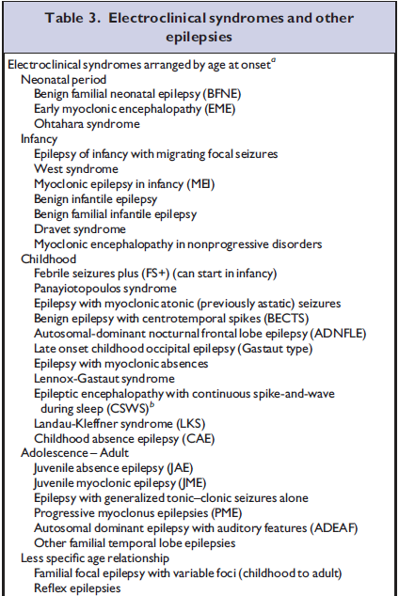
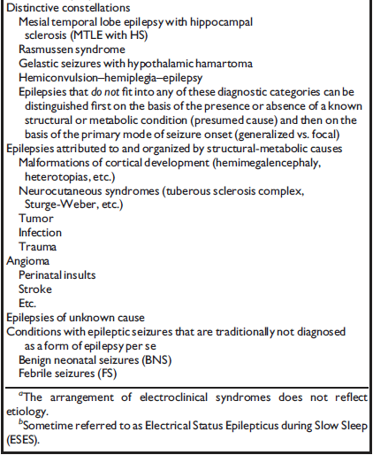
ILAE Proposed Epilepsy Classification

Slide 4
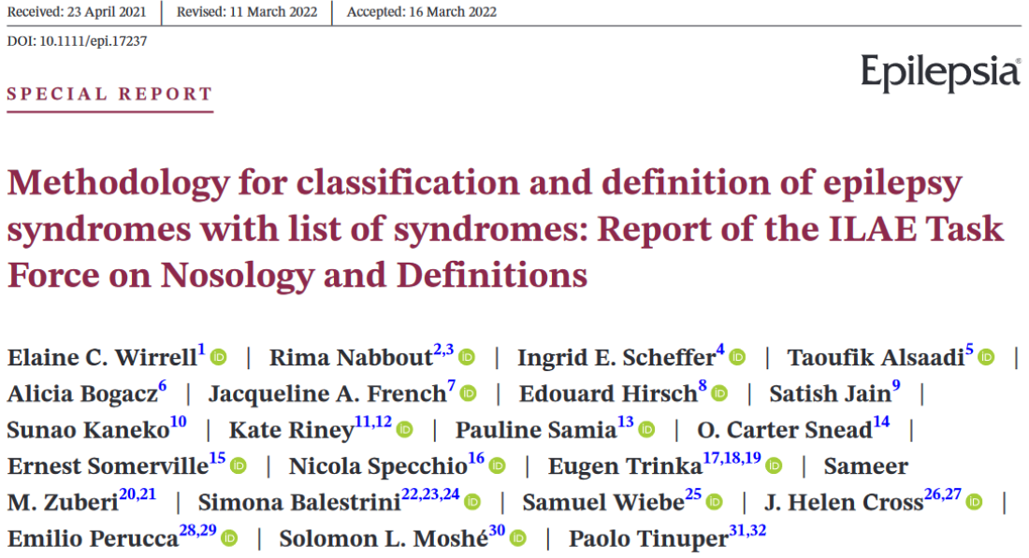
ILAE 2022 Classification and Definitions

Slide 5
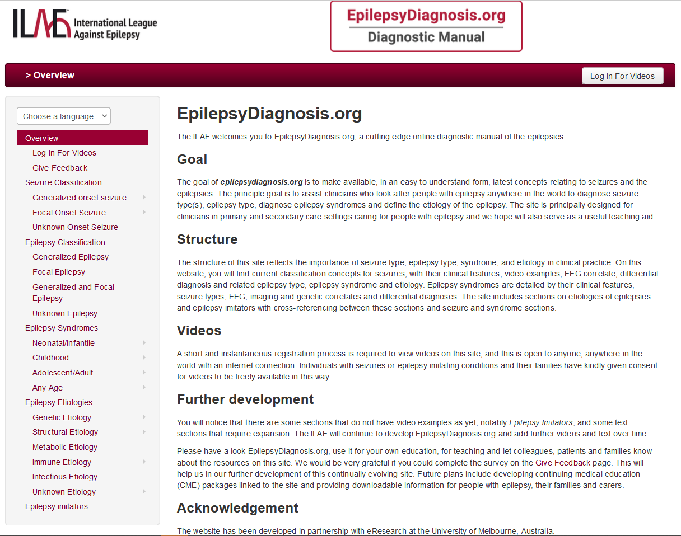

Slide 6
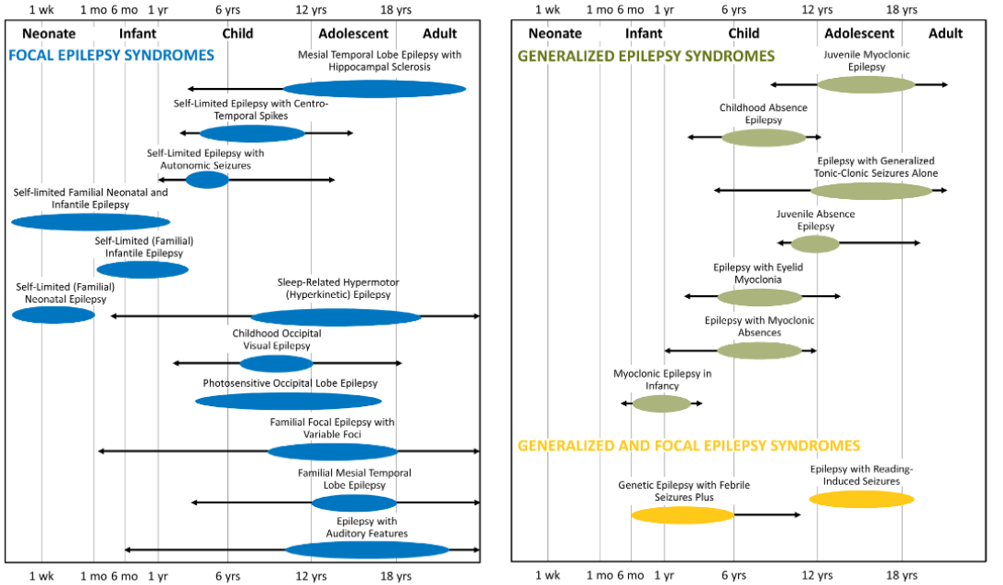
ILAE 2022 Classification and Definitions

Slide 7
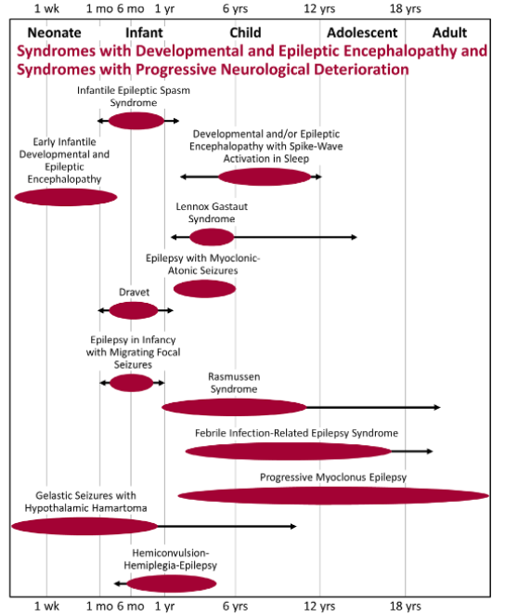
ILAE 2022 Classification and Definitions

Slide 8
Less Specific Age Relationship
Familial focal epilepsy with variable foci – DEPDC5
Reflex epilepsies

Slide 9
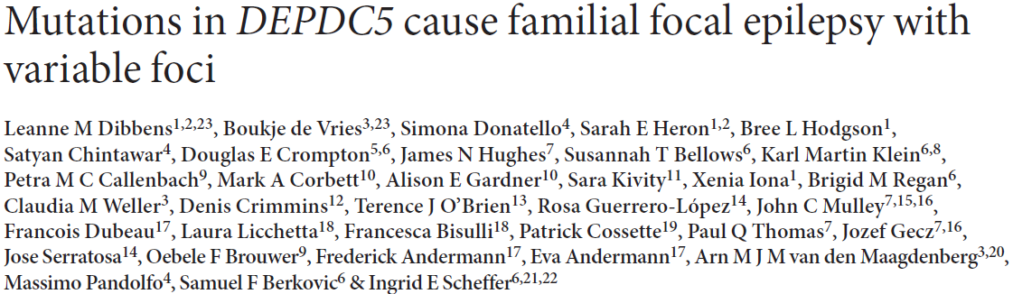

Slide 10
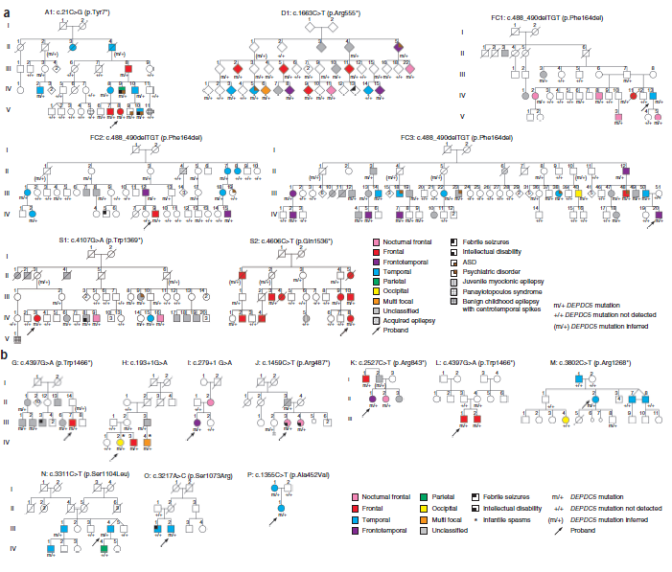

Slide 11
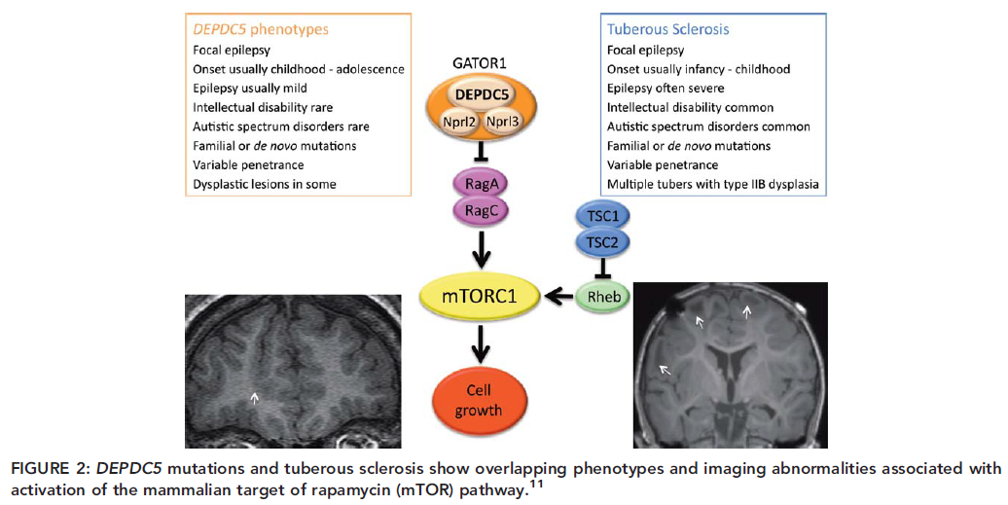

Slide 12
Reflex epilepsies
Visual/photosensitive
Eye closure sensitivity – usually repeated eyelid fluttering (ie Jeavons)
Orofacial reflex myoclonia (brought on by reading, talking, eating)
Praxis induction – muscle jerks induced by visual motor tasks
Hot water (India, Japan)
Musicogenic epilepsy
Tactile
Tooth brushing
Math
Etc
https://www.epilepsy.org.uk/info/reflex-epilepsy

Slide 13
Distinctive Constellations
Mesial Temporal Lobe Epilepsy with Hippocampal Sclerosis
Rasmussen Syndrome
Gelastic with hypothalamic hamartoma
Hemiconvulsion-hemiplegia epilepsy
[Progressive Myoclonic Epilepsies]
Other epilepsies that can be classified based on presence of absence of structural or metabolic cause and focal or generalized onset

Slide 14
Hippocampal Sclerosis
Neuronal loss in the pyramidal cell layer
  Classical HS – neuronal loss primarily involving CA1 > CA4 with relatively preserved subiculum and CA2 and variable loss from CA3
Granule cell dispersion
Mossy fiber sprouting
Chronic fibrillary gliosis
Altered interneurons
“HS Plus”/ MTS
“Dual” pathology – FCD IIIa, low-grade tumors (DNETs, gangliogliomas), vascular and cortical malformations
Notes:
Atypical forms of HS are associated with later onset of seizures (Blumcke et al., 2007; Thom et al., 2010) and second pathology (HS may be secondary to other pathology)
Extent of HS may vary along the longitudinal axis
Granule cell dispersion, obscuring the cell layer boundaries – relatively specific to the epileptogenic hippocampus (compared to aging and neurodegeneration) – associated with early seizure onset (Lurton et al., 1998), with the extent of neuronal loss in CA4 but not CA1 (Thom et al., 2010), and with longer duration of epilepsy (Blucmke, 2009)
Mossy fiber sprouting – glutamatergic granule cells (that normally project in the mossy fiber pathway to CA4 and CA3) develop recurrent collateral axons contacting apical dendrites and spines of other granule cells in the molecular layer (seen best with Timm silver method or dynorphin immunohistochemistry)
MTS – more extensive sclerosis of adjacent temporal lobe structures including the amygdala and parahippocampal gyrus; there is electrophysiologic evidence in some cases to support origin of temporal lobe seizures outside the hippocampus in other mesial temporal structures (Graebenitz et al., 2011; Kullmann, 2011)

Slide 15
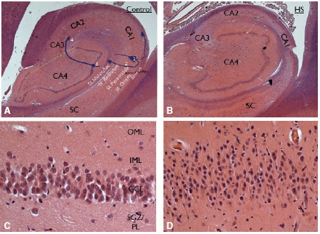
Histology
Malmgren & Thom, 2012
Notes:
Left – neurologically normal patient with (1) granule cell, apical dendrite, and (2) axonal trajectory to CA3 in the mossy fiber pathway, AND (3) CA1 pyramidal cell with apical dendrite extending into the striatum moleculare and its outgoing axon (4) in the alveus (arrow)
Right – patient with long history of TLE; note cell loss in CA1 and the intact SC
C – normal granule cell layer with inner molecular layer (IML), outer molecular layer (OML), subgranular zone (SGZ) and polymorphic cell layer (PL)
D- granule cell dispersion, obscuring the cell layer boundaries – relatively specific to the epileptogenic hippocampus (compared to aging and neurodegeneration) – associated with early seizure onset (Lurton et al., 1998), with the extent of neuronal loss in CA4 but not CA1 (Thom et al., 2010), and with longer duration of epilepsy (Blucmke, 2009)

Slide 16
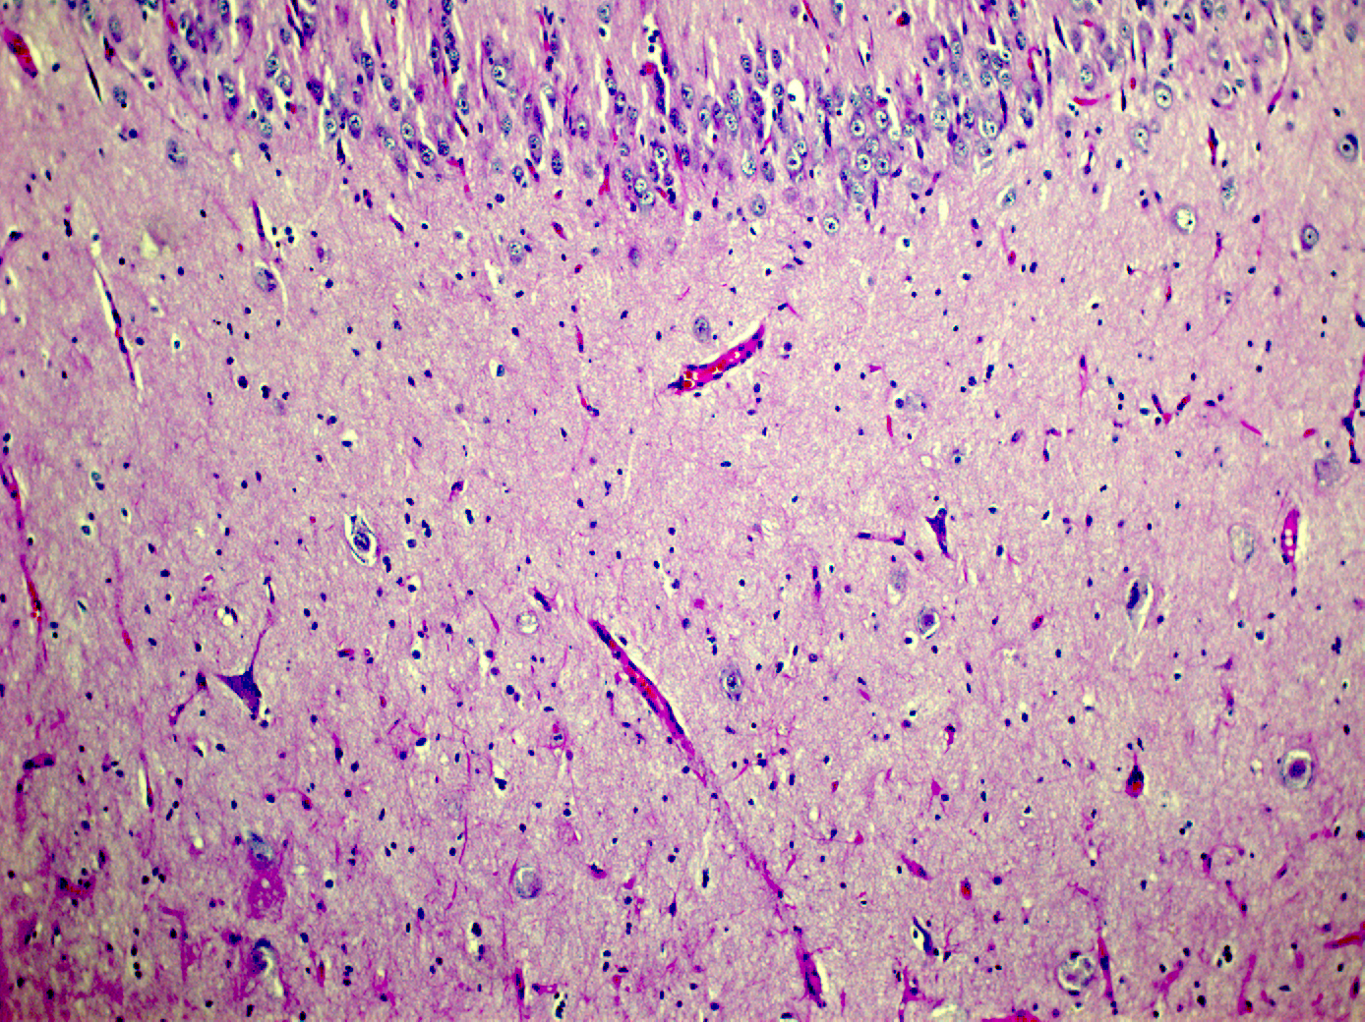
Notes:
The CA-4 region of the Ammon’s horn inside dentate fascia. This area should have a large number of large neurons. However, only a few remain (arrows)

Slide 17
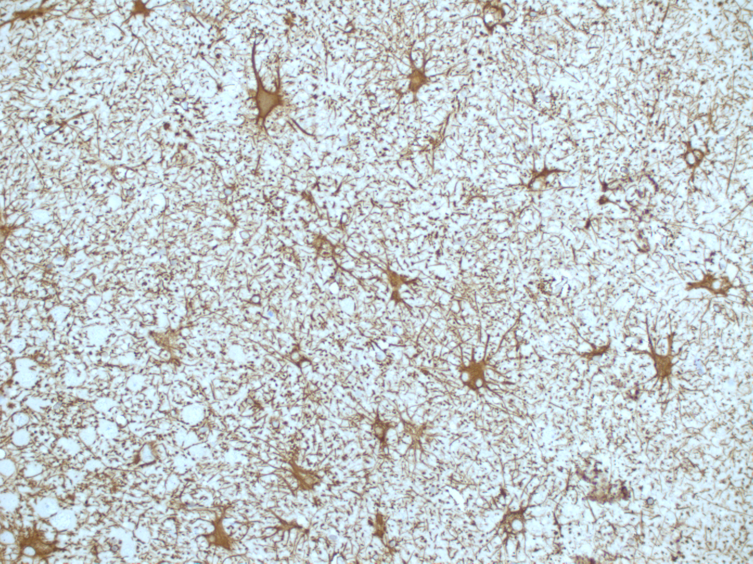
Notes:
Closer view of the same with plump astrocytes having copious cytoplasm stained brown with the GFAP stain. This is diagnostic of Hippocampal (mesial temporal) sclerosis.

Slide 18
History of Hippocampal Sclerosis
HS is the most common pathologic finding in adult epilepsy surgery
Ammon’s horn sclerosis linked to epilepsy – Sommer (1880) and Bratz (1899)
  Neuronal loss largely restricted to CA1 (cornu ammonis)
Jackson & Beevor (1889) – associated clinical symptoms of TLE with focal lesions in hippocampus
Sano and Malamud (1953) – associated HS with EEG evidence of TLE
Jackson et al., 1990; Berkovic et al., 1991 – recognized that MRI can detect HS
Notes:
From ram-headed Egyptian god Ammon
Blumcke I. Neuropathology of focal epilepsies: a critical review. Epilepsy Behav 2009, 15: 34-39.
Berkovic SF, Andermann F, Olivier A, et al. Hippocampal sclerosis in temporal lobe epilepsy demonstrated by magnetic resonance imaging. Ann Neurol 1991, 29: 175-182.
Jackson GD, Berkovic SF, Tress BM, et al. Hippocampal sclerosis can be reliably detected by magnetic resonance imaging. Neurology 1990, 40: 1869-1875.

Slide 19
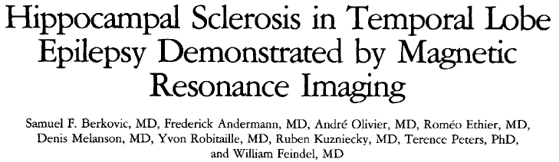
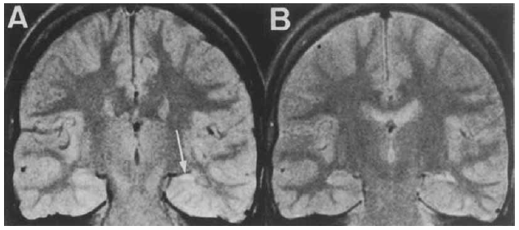
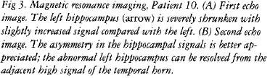
Notes:
Selected 10 patients with clear history of early childhood convulsions associated with fever or encephalitis and adequate coronal MRI studies (out of 50 patients from 1985-1986 at MNI with TLE who had ATL)
Philips 0.5 T scanner; T2-weighted spin-echo sequences with echo times 50 and 100 msec and repetition time 1600 msec were performed in the axial and corontal planes (T1 had TE 25 ms, TR 500 ms)
All 10 patients had unilateral increased signal and decreased size in the affected hippocampus; 5 had associated decrease in size of the ipsilateral temporal lobe
Subpial ultrasonic dissection at MNI seldom allows for adequate pathological examination, but 3 had gliosis and neuronal loss – the rest of the specimens were unavailable

Slide 20
MRI features of HS
T2 hyperintensity (hippocampal hyperintense FLAIR signal occurs in about 1/3 of normal controls (Labate et al., 2010) but is not associated with hippocampal atrophy
Reduced hippocampal volume
Disturbed internal architecture
Others
  Temporal lobe atrophy
  Dilatation of the temporal horn
  Blurring of the gray-white junction
Labate A, Gambardella A, Aguglia U, et al. Temporal lobe abnormalities on brain MRI in healthy volunteers: a prospective case-control study. Neurology 2010, 74: 553-557.
Notes:
Labate A, Gambardella A, Aguglia U, et al. Temporal lobe abnormalities on brain MRI in healthy volunteers: a prospective case-control study. Neurology 2010, 74: 553-557.
Discuss PET findings in MTLE

Slide 21
Temporal Lobe Epilepsy and HS/ MTS
Kim et al., 1999 – 104 patients with MTS followed for > 2 years
  25% completely controlled with adequate therapy
  37% had ≥50% reduction in seizures
  38% intractable
Kobayashi et al., 2001 – 98 patients with epilepsy (68 with MTLE); HS in 48/84 (57%) who had MRI; proportion of HS in MTLE outcome groups
  6/13 (46%) remission
  16/31 (51%) good seizure control
  16/16 (100%) with refractory MTLE
Notes:
Kim WJ, Park SC, Lee SJ, et al. The prognosis for control of seizures with medications in patients with MRI evidence for mesial temporal sclerosis. Epilepsia 1999, 40: 290-3.

Slide 22
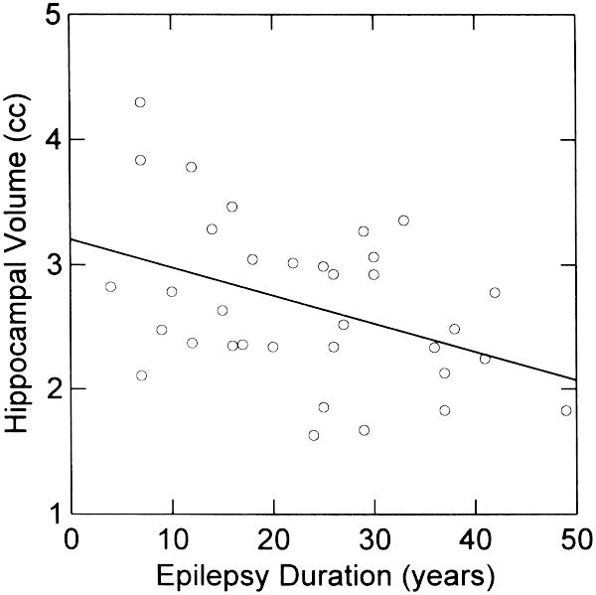
HS and Epilepsy Duration
22500
Autopsy
20000
TLE-HS
17500
15000
12500
AVE AH Counts
10000
7500
5000
2500
0
0
10
20
30
40
50
SZ Duration
Mathern et al., 2002
Theodore et al., 1999
Notes:
Mathern GW, Adelson PD, Cahan LD, Leite JP. Hippocampal neuron damage in human epilepsy: Meyer’s hypothesis revisited. Prog Brain Res 2002, 135: 237-251. – 572 hippocampal specimens from TLE patients compared to 73 with extra-temporal seizures and pathologies; HS not a consequence of aging; HS was strongly linked to an initial precipitating injury in both TLE and extra-temporal seizure patients; in TLE, IPIs occurred at an earlier age and often involved seizures
Theodore WH, Bhatia S, Hatta J, et al. Hippocampal atrophy, epilepsy duration, and febrile seizures in patients with partial seizures. Neurology 1999, 52: 132-136. – 35 patients with uncontrolled CPS and temporal lobe ictal onset on LTVEEG; the effect of duration, but not age at onset or scan was significant in multivariate analysis; the 9 with a history of complex or prolonged FS had smaller ipsilateral HF volume than patients without a history of FS

Slide 23
Rasmussen Syndrome
Mean age of onset 5 years, most 14 months – 14 years
Seizures are the initial manifestation – GTC, focal motor, complex partial
Epilepsia partialis continua in 56%
Progressive hemiparesis and usually cognitive deterioration
Prodromal period → acute phase → residual stage
Neuroimaging – progressive hemispheric atrophy
CSF – oligoclonal or monoclonal bands
Pathology – chronic inflammatory changes with intense perivascular cuffing, microglia, astrocytosis, neuronal cell loss
Treatment:
  Medical
  Hemispherectomy – could be considered earlier to limit dysfunction in the contralateral hemisphere

Slide 24
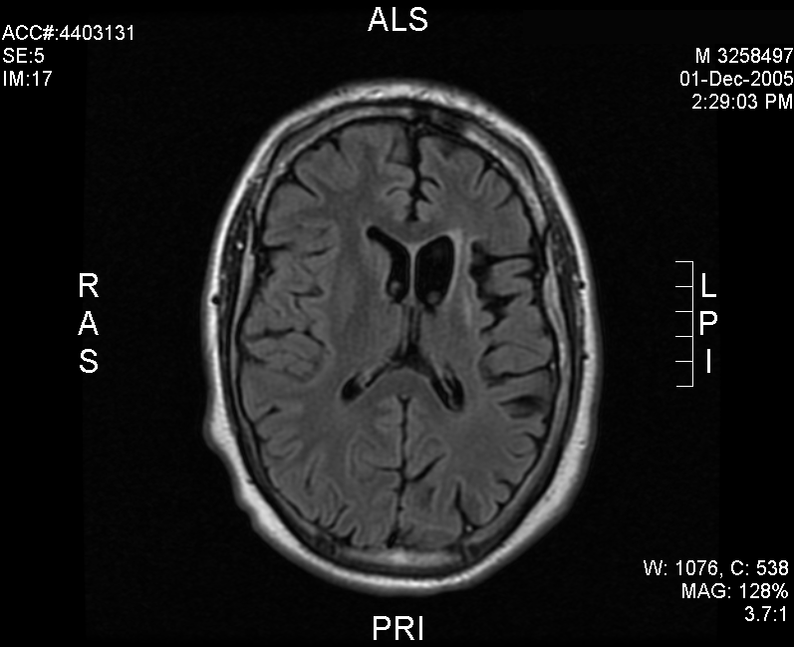
Rasmussen Syndrome: Diagnosis
Part A (3/3):
Clinical: Focal seizures (+/- Epilepsia partialis continua) & Unilateral cortical deficit(s)
EEG: Unihemispheric slowing +/- epileptiform activity & Unilateral seizure onset
MRI: Unihemispheric focal cortical atrophy and at least one of the following:
Grey or white matter T2/FLAIR hyperintense signal
Hyperintense signal/atrophy of ipsilateral caudate head
Part B (2/3):
Clinical: Epilepsia partialis continua or Progressive unilateral cortical deficit(s)
2. MRI: Progressive unihemispheric focal cortical atrophy
3. Histopathology: T cell dominated encephalitis w/activated microglial cells (typically, but not necessarily forming nodules) & reactive astrogliosis
Bien CG et al., Brain 2005;128:454

Slide 25
Gelastic seizures with hypothalamic hamartoma
Classic description: gelastic seizures (“mirthless laughter”), other seizure types (focal or generalized), crying-like sounds
Precocious puberty
Cognitive problems and decline
Behavior problems: hyperactivity, rage, aggression, oppositional defiant disorder, ADHD, conduct disorder, affective disorders
EEG findings highly variable (incl normal) and seizures may appear to arise from various locations; some with temporal lobe dysplasia
HH has intrinsic epileptogenicity
Drugs ineffective; surgery usually effective
Mittal et al., Neurosurg Focus 2013;34:E6

Slide 26
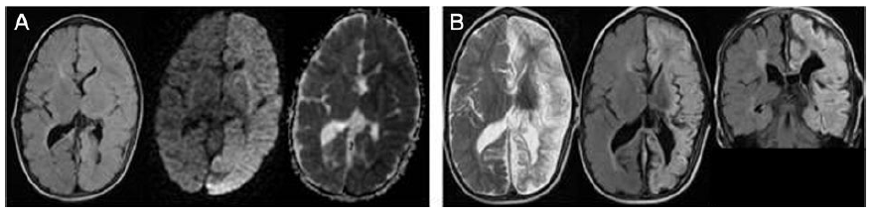
Hemiconvulsion-hemiplegia-epilepsy
Onset: 85% 6 months-4 years old
Classic description: initial prolonged focal/generalized status epilepticus, then hemiplegia (may resolve in < 12 months in 20%)
Radiologic: acute cytotoxic edema followed by chronic atrophy
Decreasing incidence due to better early seizure control? (1967 – 7.5/10,000; 1978 – 1.6/10,000)
Subtypes
  “Idiopathic” – fever, extracranial infection
  “Symptomatic” – associated with other pathology (trauma, infection, stroke)
Tenney & Schapiro, Neurology 2012;79:e1

Slide 27
Progressive myoclonus epilepsies (PME)
Myoclonus, Epilepsy (GTC, CTC, C, others), dementia, usually with cerebellar manifestations
<1% of epilepsies (Genton et al, in Roger) – 2273 total newly referred epilepsy cases
Unvericht-Lundborg disease (Baltic myoclonus)- 63
Lafora disease - 41
Neuronal ceroid lipofuscinosis - 15
Myoclonic epilepsy with ragged red fibers (MERRF) - 2
Also: other mitochondrial disorders, sialidosis, dentatorubral-pallidoluysian atrophy, biotinidase deficiency, Gaucher’s type III, Huntington disease, pantothenate kinase-associated neurodegeneration, subacute sclerosing panencephalitis, Creutzfeld-Jacob disease

Slide 28
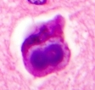
EPM1 & 2
Unvericht-Lundborg syndrome
Lafora disease (EPM2)
Autosomal recessive
Chromosome 21q22
Cystatin B
Present at 6-18 yrs (mostly 9-13 yrs) but survive to adulthood
Myoclonus before ataxia and dementia
Cognitive impairment – nil-moderate
Autosomal recessive
Chromosome 6
Laforin (EPM2A) or malin (EPM2B)
Present at 6-19 yrs and have a rapid decline
Seizures, visual seizures (~50%), then ataxia and dementia
Very photosensitive
Death in 2-10 yrs
Photo: Frontalcortex.com
Notes:
Lafora bodies – polyglycosans most prominent in sweat duct cells

Slide 29
Neuronal ceroid lipofuscinosis (NCL)
Variable ages of onset
Seizures, visual changes, ataxia, cognitive decline
EEG: typically, background becomes abnormal over time, epileptiform activity, photosensitivity with giant evoked potentials
Imaging: progressive atrophy
Genetics (next slide): autosomal recessive but CLN4 is dominant
Diagnosis: genetics or biopsy of axilla (sweat glands), muscle, conjunctiva, rectum

Slide 30
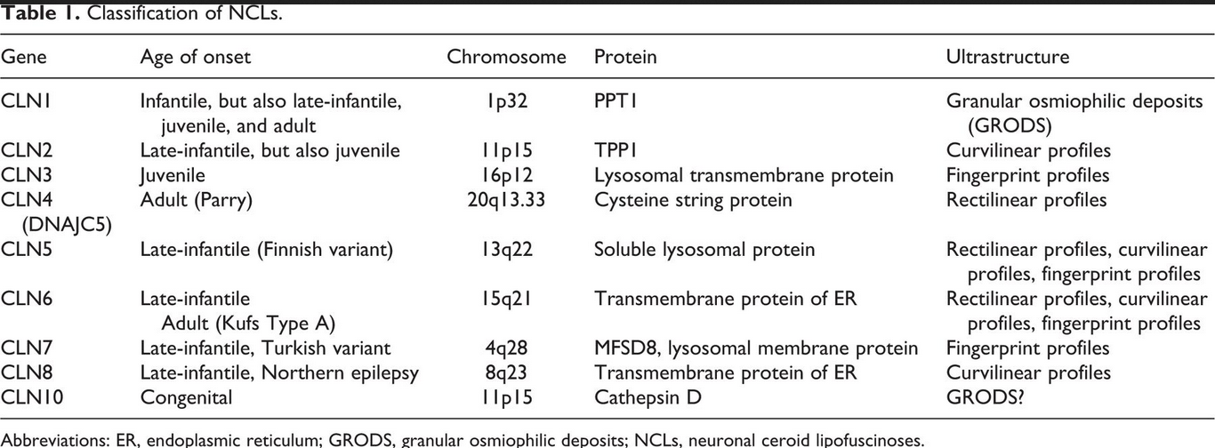
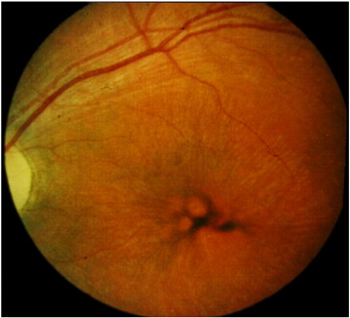
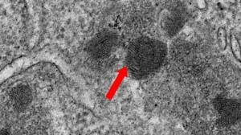
Neuronal ceroid lipofuscinosis (NCL)
Mink et al., J Child Neurol 2013;28:1101
Schultz et al., Biochim Biophys Acta 2013;1832:1801
beyondbatten.org/understanding-batten/diagnosis-symptoms/

Slide 31
Epilepsies attributed to and organized by structural-metabolic cause
Malformations of cortical development
Neurocutaneous syndromes
Tumor
Infection
Trauma
Angioma/ vascular (cavernoma, AVM)
Perinatal insults
Stroke
Metabolic/ Mitochondrial

Slide 32
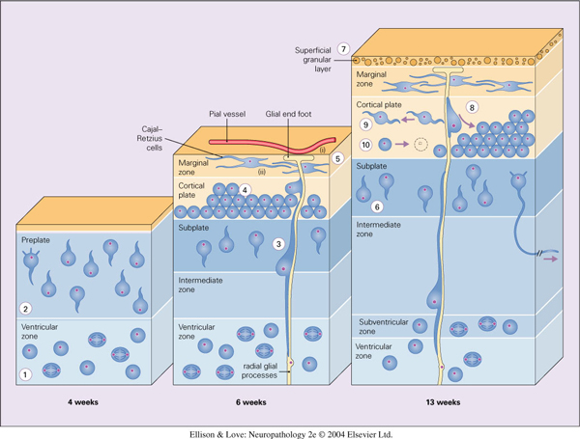
Cerebral Cortex Embryology
Week 7: proliferation of neuroblasts in the germinal matrix
Week 8: radial migration begins
Migration along radial glial cells (dependent on recognition, attachment, and calcium entry/ NMDA activation)
Neurons migrate in an inside out sequence (except for layer 1 – molecular layer)
Notes:
The above applies to glutamatergic and GABAergic neurons alike
Up to 35% of GABAergic neurons seem to be generated in the striatal ventricular zone, where most basal ganglia neurons are formed; these neurons migrate along axons parallel to the cortical surface within developing cerebral mantle, perpendicular to the radial glial cells (tangential)

Slide 33
Etiology of MCD
Mutations
  Stem cell production
  Radial glial fascicle development
  Neuronal migration
  Ability to disengage from radial glial fascicle and organize
Destructive events
  Infection
  Ischemia
Exogenous/ endogenous toxins
  Drugs/ alcohol
  Metabolic disorders (PDH deficiency, NKH)
Notes:
Early insult – abnormal appearing neurons
Late insult – normal but disorganized neurons, usually with normal white matter (no signal hyperintensity)
The laminar fate of neurons is determined in progenitor cells prior to their final mitosis

Slide 34
MCD

Slide 36
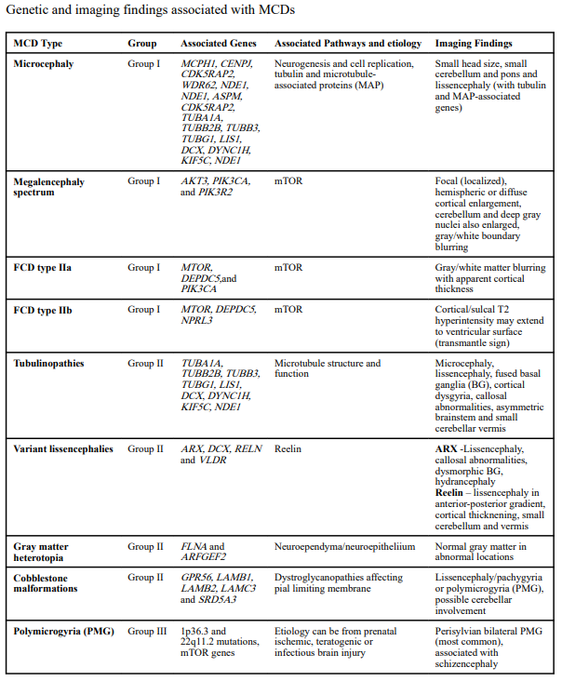

Slide 37
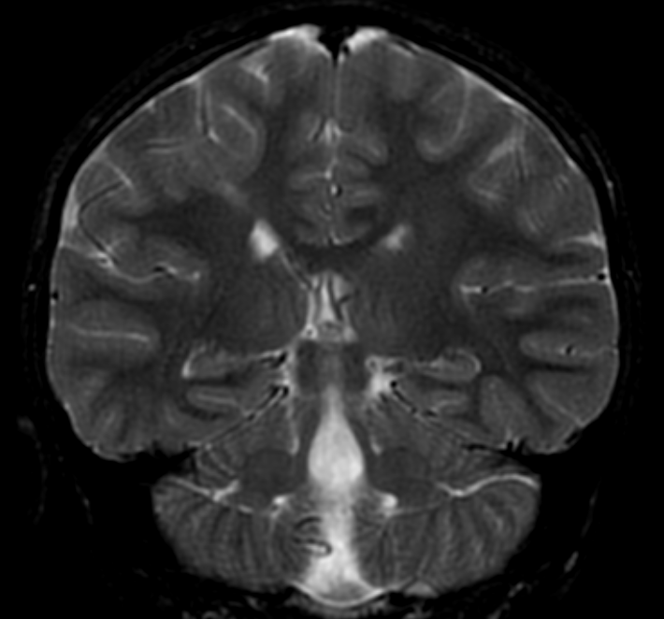
Focal Cortical Dysplasia
Altered cell morphology
Altered synaptic connectivity/ disrupted cytoarchitecture
Changes in ion channel or neurotransmitter receptor expression

Slide 38
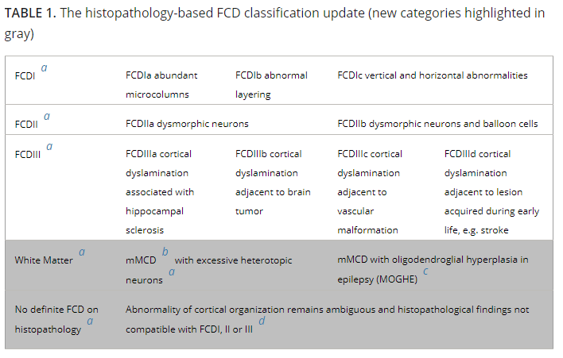
FCD Classification Schema (ILAE)
Najm et al., Epilepsia 2022

Slide 39
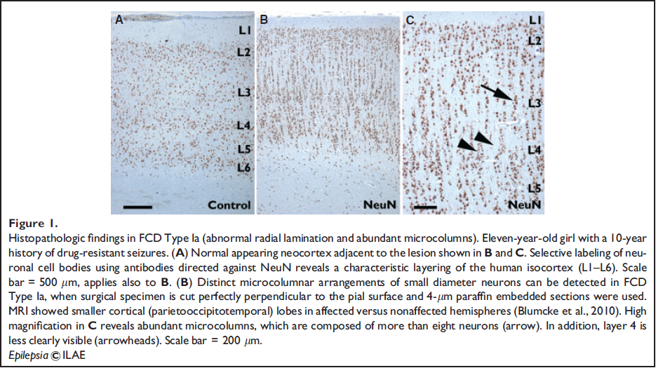
FCD Ia

Slide 40
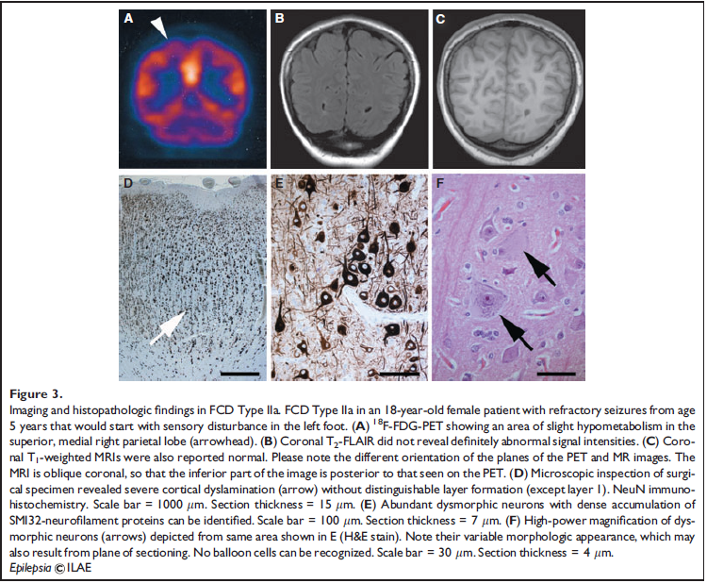
IIa

Slide 41
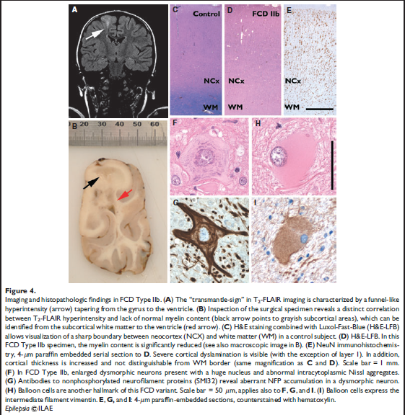
IIb

Slide 42
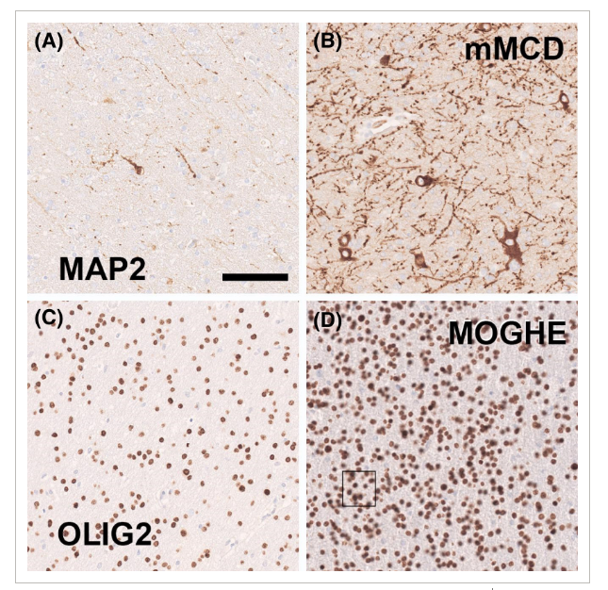
mMCD and MOGHE
mMCD (mild malformation of cortical development) – excess heterotopic neurons in WM
MOGHE (mMCD with oligodendroglial hyperplasia in epilepsy) – increase in heterotopic neurons in WM and high oligodendroglial cell density; 45-100% have SLC35A2 somatic variants
Najm et al., Epilepsia 2022

Slide 43
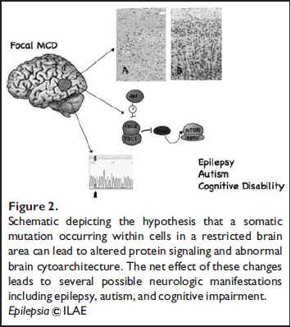
mTOR, TSC, and FCD type IIb
Loss of function mutations in TSC1 or TSC2 lead to constitutive activation of mTOR
Activation of mTOR signaling distinguishes type II from type I FCD

Slide 44
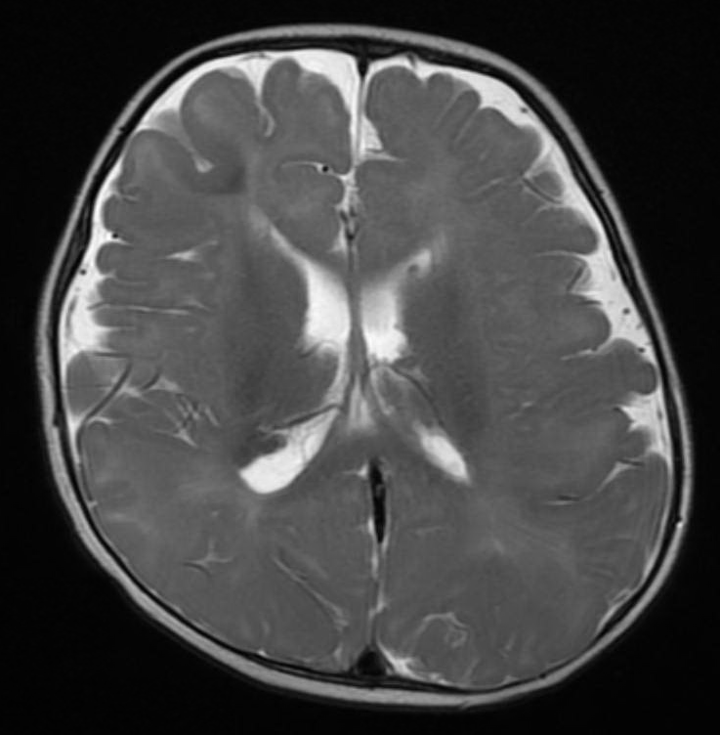
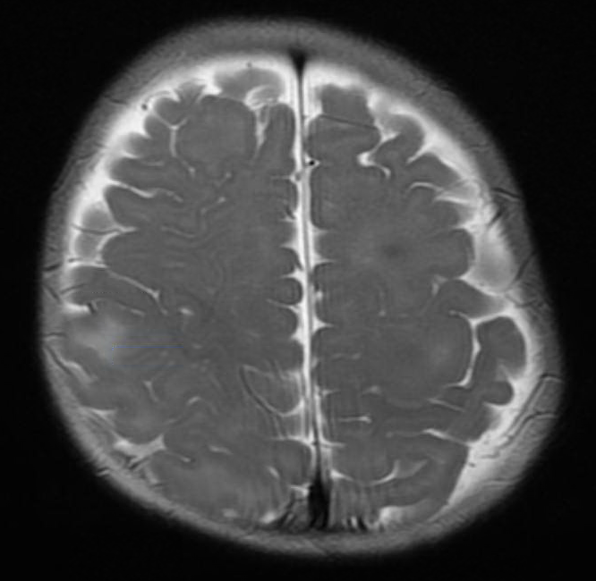
Tuberous Sclerosis Complex

Slide 45
Definite TSC: Two major OR one major + two minor
Probable TSC: One major + one minor
Possible TSC: One major feature OR two or more minor
Genetic diagnosis: A pathogenic variant in TSC1 or TSC2 is diagnostic for TSC (most TSC-causing variants are sequence variants that clearly prevent TSC1 or TSC2 protein production. Some variants compatible with protein production [e.g., some missense changes] are well established as disease-causing; other variant types should be considered with caution)
Major Features
Facial angiofibromas or forehead plaque
Ungual or periungual fibromas
≥ 3 Hypomelanotic macules
Shagreen patch
Multiple retinal nodular hamartomas
Cortical tuber
Subependymal nodule (SEN)
Subependymal giant cell astrocytoma
Cardiac rhabdomyoma
Lymphangiomyomatosis
Renal angiomyolipoma
Minor Features
Multiple randomly distributed pits in dental enamel
Hamartomatous rectal polyps
Bone cysts
Cerebral white matter radial migration lines
Gingival fibromas
Nonrenal hamartoma
Retinal achromic patch
"Confetti" skin lesions
Multiple renal cysts

Slide 46
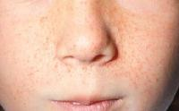
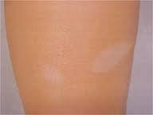
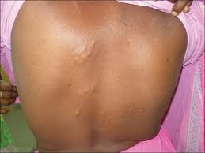
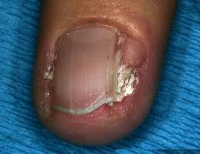
Skin exam findings in TS

Slide 47
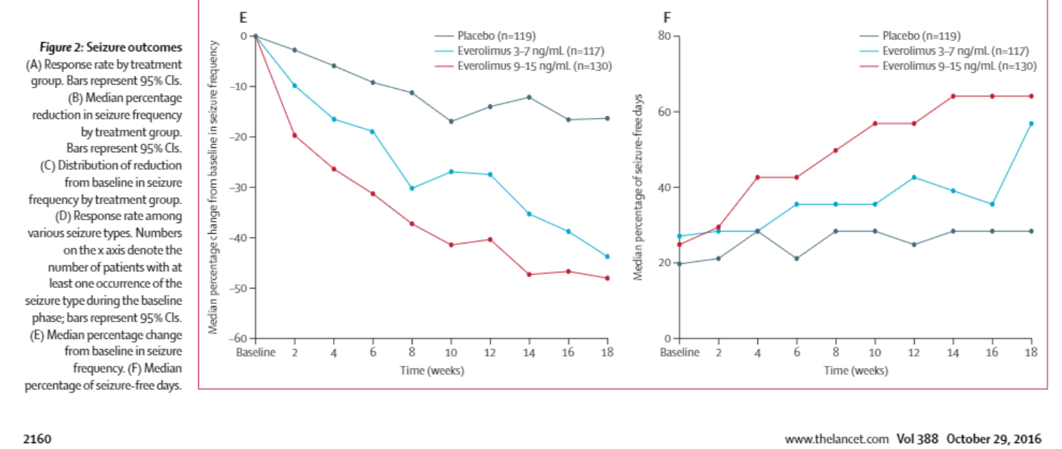
Tuberous Sclerosis Complex
PREVeNT Trial
  Early identification of EEG biomarkers
  Early treatment versus delayed treatment with vigabatrin
  Outcomes
    developmental outcomes at 24 months
    infantile spasms and refractory seizures
Everolimus
  Now approved for focal seizures associated with TSC

Slide 48
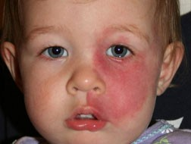
Sturge-Weber
Facial port-wine stain in the distribution of the ophthalmic branch of the trigeminal nerve (may be absent in 15% of Sturge-Weber syndrome patients); 26% with V1 have SWS (Ch’ng et al., 2008)
Leptomeningeal angioma ipsilateral to the side of the port-wine stain, over occipital and posterior parietal regions predominantly, causing ischemia, atrophy and calcification in the affected cortex
Ocular (choroidal, scleral) angioma (in 30% of patients), causing glaucoma, iris heterochromia, or buphthalmos.
Seizures are seen in 75-90% of patients, usually starting at < 12 months; may also have hemiparesis, hemianopsia
https://www.epilepsydiagnosis.org/aetiology/sturge-weber-overview.html

Slide 49
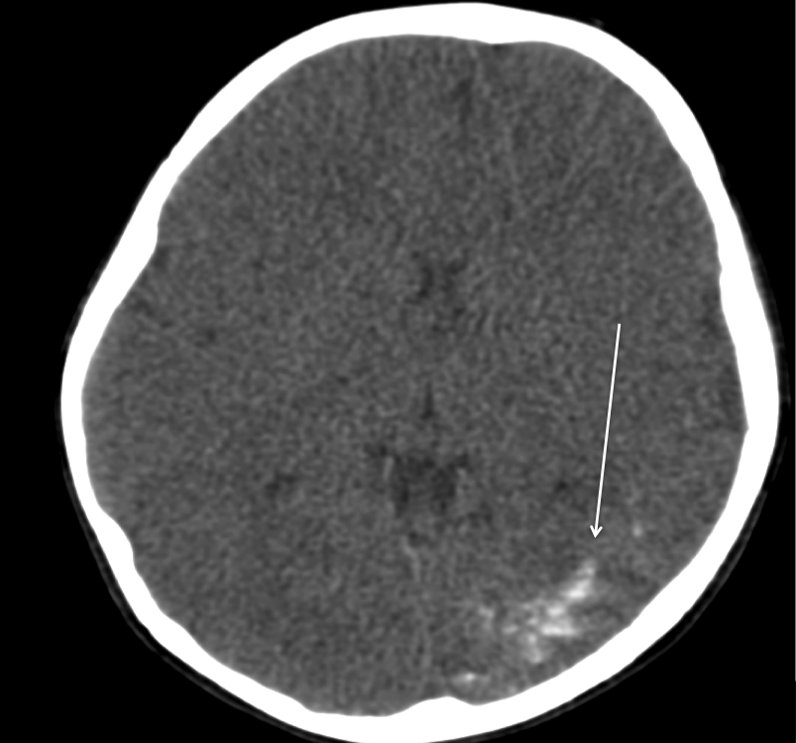
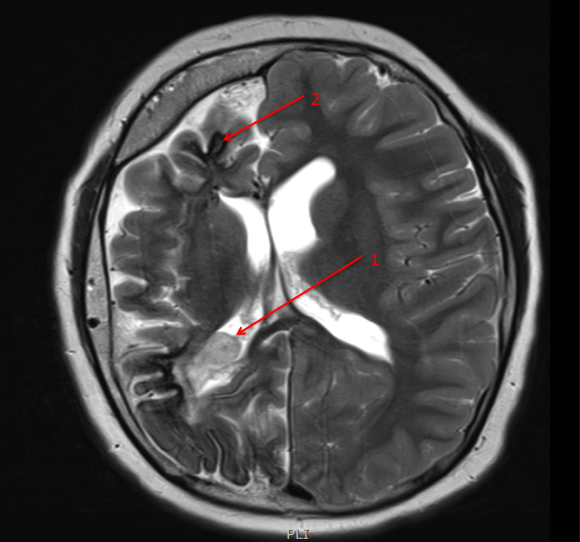
*Sturge-Weber syndrome can be classified according to the presence/absence of facial and leptomeningeal angiomas:
type I: represents classic syndrome, with both facial and leptomeningeal angiomas; may have glaucoma
type II: facial angioma without evidence of intracranial disease; may have glaucoma
type III: isolated leptomeningeal angioma; usually no glaucoma
*Roach et al (1992)
Treatment:
Surgical resection indicated in refractory epilepsy
Ophthalmologic exam
https://www.epilepsydiagnosis.org/aetiology/sturge-weber-imaging.html

Slide 50
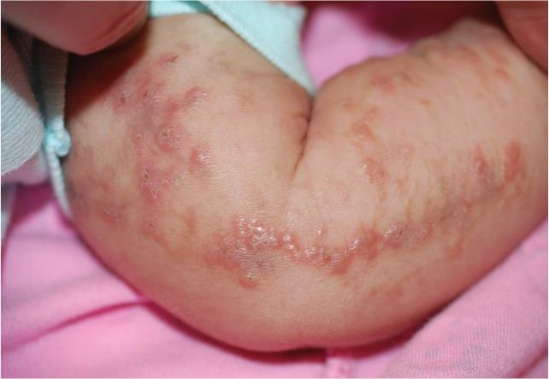
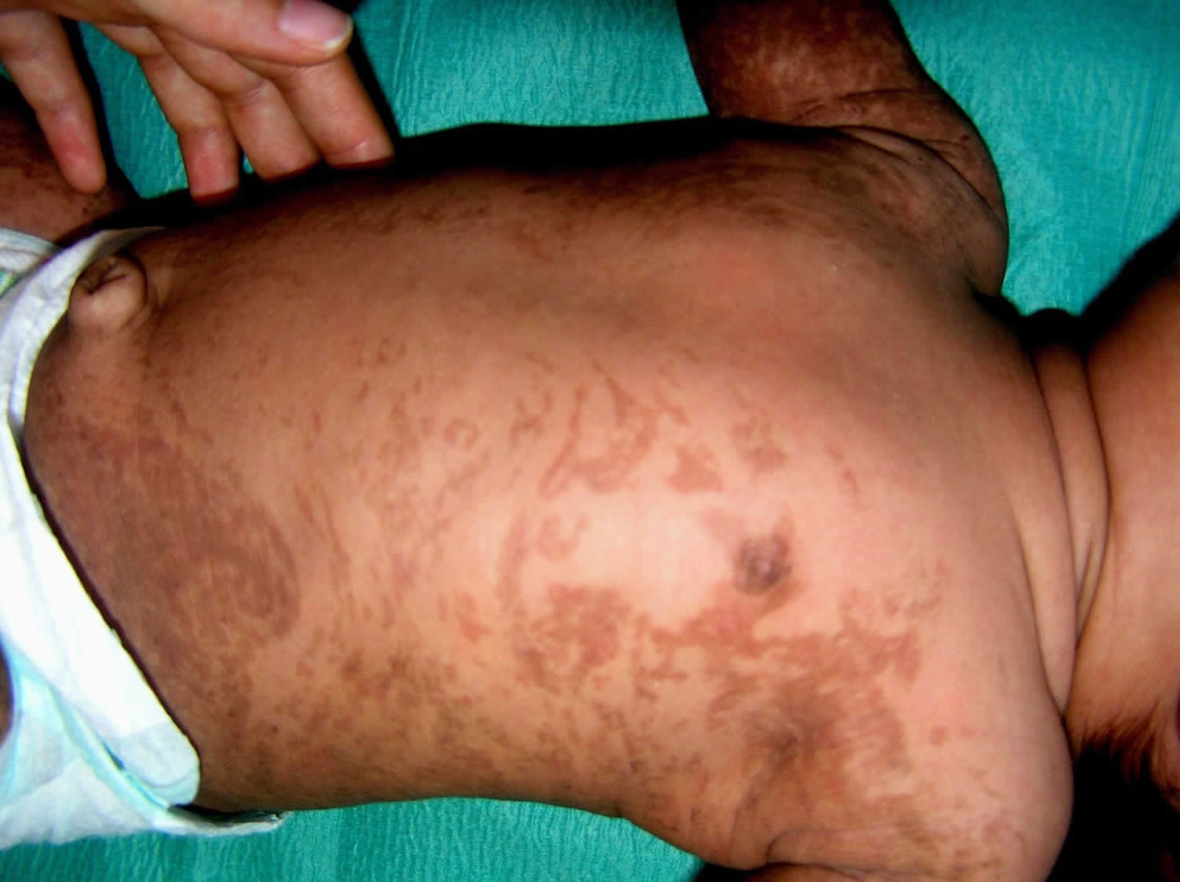
Incontinentia Pigmenti
X-linked dominant due to mutations in IKBKG
Skin: erythema, blisters, boils (birth/ infancy) → wart-like verrucous lesions (birth/ infancy) → hyperpigmented lesions (6-12 months) → atrophic stage (pale/ hypopigmented and hairless)
Dental abnormalities in 50-75%
Nail abnormalities
Ocular abnormalities in 1/3
Neurological abnormalities in 1/3 (stroke, seizures, developmental delay)
https://rarediseases.org/rare-diseases/incontinentia-pigmenti

Slide 51
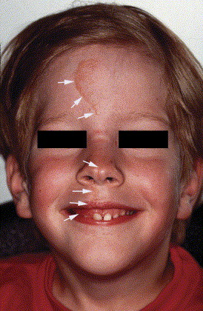
Nevus Sebaceous Syndrome (of Jadassohn)
Postzygotic mutations in KRAS and HRAS (mosaic RAS mutations, regulating cell survival, proliferation, and differentiation) (Pan et al., BMC Med Gen. 2020;13:188)
Hairless, yellow–orange plaques of varying sizes and shapes, and is most frequently located in areas with abundant sebaceous glands; ~7% have extracutaneous manifestations, primarily CNS (Davies et al., Austr J Dermatol. 2002;43(1):20–3; Chiang et al., Pediatr Neurosurg. 2019;54(3):201–6)
Associated with seizures and various malformations of cortical development and other cerebral malformations (eg ACC)
Other – ocular, skeletal, craniofacial

Slide 52
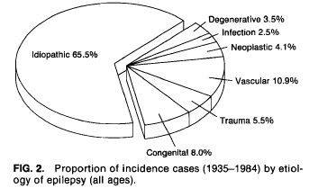
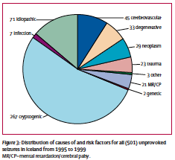
Tumor - Epidemiology
Proportion of incident epilepsy cases with brain tumors – 4-6%^{1, 2}
Hauser WA, Annegers JF, Kurland LT. Incidence of epilepsy and unprovoked seizures in Rochester, Minnesota: 1935-1984. Epilepsia 1993, 34: 453-68.
Olafsson E, Ludvigsson P, Gudmundsson G, et al. Incidence of unprovoked seizures and epilepsy in Iceland and assessment of the epilepsy syndrome classification: a prospective study. Lancet Neurol 2005, 4: 627-34.
Notes:
Epilepsy defined in both studies as recurrent, unprovoked seizures (not related to acute trauma, metabolic disturbance, etc.)

Slide 53
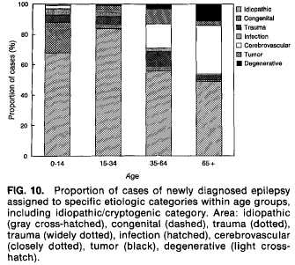
Etiology according to age

Slide 54
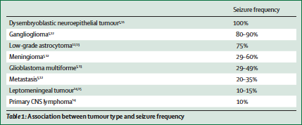
Seizure frequency according to tumor type
Van Breemen MS, Wilms EB, Vecht CJ. Epilepsy in patients with brain tumours: epidemiology, mechanisms, and management. Lancet Neurol 2007, 6: 421-30.
Notes:
DNETs and Ganglioglioma – more slow-growing

Slide 55
Seizure frequency according to tumor location
Supratentorial 22-68% vs. infratentorial 6%
Superficial/ cortical 63% vs. non-cortical/ deep 29%
Parietal, temporal, frontal > occipital
Increased seizure incidence with proximity to rolandic fissure
Recht LD, Glantz M. Neoplastic diseases. In: Engel J, Pedley TA, eds. Epilepsy: A Comprehensive Textbook. Philadelphia: Lippincott-Raven, 1998: 2579-85 (vol 3).
Lynam LM, Lyons MK, Drazkowski JF, et al. Frequency of seizures in patients with newly diagnosed brain tumors: A retrospective review. ClinNeurolNeurosurg 2007, 109: 634-8.
Notes:
Lynam – no DNETs or gangliogliomas;primary location showed a trend (numbers not reported)
Wolf – 7 low-grade gliomas, 2 gangliogliomas, 2 DNETs, 4 glioneuronal malformations, 5 vascular malformations, and 10 glial or gliomesodermal scars in patients with chronic pharmacoresistant epilepsy; 73% exhibited distinct difference in immunoreactivity for GABAR, GAD, or NR1 between the perilesional zone and normal cortex
Epileptogenicity may be due to direct physical effects, altered ion homeostasis or neurotransmitter trafficking, changes in gene expression, disruption of neuronal networks, or reduction of extracellular space; fast-growing tumors may result in bleeds (hemosiderin deposition) or tissue necrosis, hypoxia, or edema (although no clear relation has been found between seizure frequency and mass effect or edema

Slide 56
Epileptogenesis
Lesions are often electrically inert; epileptogenic activity probably arises from perilesional tissue
Mirror focus – actively discharging epileptiform region may induce similar activity in a homologous site
1. Wolf HK, Roos D, Blumcke I, et al. Perilesionalneurochemical changes in focal epilepsies. ActaNeuropathol 1996, 91: 376-84.
2. Gilmore R, Morris H 3rd, Van Ness PC, Gilmore-Pollak W, Estes M. Mirror focus: function of seizure frequency and influence on outcome after surgery. Epilepsia 1994, 35: 258-63.
Notes:
Gilmore – Patients with complex partial seizures for > 3 years and pathologically proven temporal lobe neoplasms; 6/7 patients with mirror focus were seizure free at follow-up compared to 10/15 without mirror focus; no statistically significant demographic features; 3 patients had subtotal resection due to tumor overlap with eloquent cortex; concluded that mirror focus is not a contraindication to operation even when most interictal spikes are contralateral or when seizures appear to arise from the mirror focus
Mirror focus is seen more frequently with temporal tumors

Slide 57

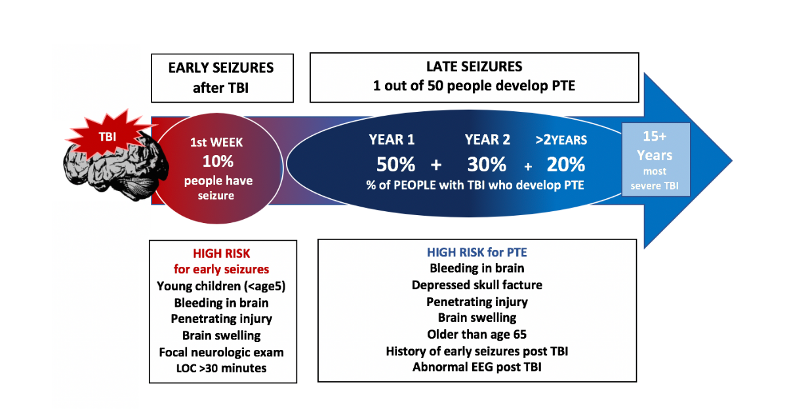
Seizures after TBI
Early (< 1 week)
Late (> 1 week)

Slide 58
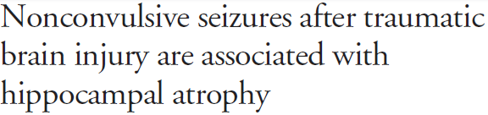



Notes:
32/140 patients with TBI and GCS 3-12 who underwent cEEG had electrographic seizures
29/140 had acute and chronic volumetric MRI and 6/29 had seizures (all non-convulsive without apparent motor signs), 4/6 with NCSE (> 10 min definition) compared with 10 matched patients without seizures based on age, CT lesion, and initial GCS; each patient had multiple seizures
No patients in the seizure group had evidence of hippocampal injury on imaging
No association between hippocampal atrophy and ICP, bp, initial GCS, or # of hemorrhages on initial MRI GRE sequence
Similar outcomes between groups (GOS-E 6 ± 1.3 vs 5.1 ± 1.3, p = 0.19) (GOS-E scale 1-8, dead – upper good recovery)

Slide 59

Salmenperä T, Kälviäinen R, Partanen K, Pitkänen A. Quantitative MRI volumetry of the entorhinal cortex in temporal lobe epilepsy. Seizure 2000, 9: 208-215.
Notes:
Salmenperä T, Kälviäinen R, Partanen K, Pitkänen A. Quantitative MRI volumetry of the entorhinal cortex in temporal lobe epilepsy. Seizure 2000, 9: 208-215.

Slide 60

Risk Factors – Stroke in Children
Risk Factors
Childhood AIS (IPSS)
  N=676
  2003-2007
  30 centers
  Median age – 5.9 y
  52% with multiple RF
Percentage of Total Cases
Mackay MT, Wiznitzer M, Benedict SL, Lee KJ, Deveber GA, Ganesan V; International Pediatric Stroke Study Group. Arterial ischemic stroke risk factors: the International Pediatric Stroke Study. Ann Neurol. 2011

Slide 61

Focal Cerebral Arteriopathy
Imaging 6 years post stroke

Slide 62
Infection
Viral encephalitis
Bacterial meningitis
Abscess
Neurocysticercosis
Cerebral malaria
TORCH infections (toxoplasmosis, rubella, CMV, HSV, Zika, etc)
Tuberculosis
HIV
HSV
Etc

Slide 63
Immune Etiology
ANTI-NMDA RECEPTOR ENCEPHALITIS
VOLTAGE-GATED POTASSIUM CHANNEL ANTIBODY
GAD65 ANTIBODY
GABA-B RECEPTOR ANTIBODY
AMPA RECEPTOR ANTIBODY
STEROID-RESPONSIVE ENCEPHALOPATHY ASSOCIATED WITH THYROID DISEASE
CELIAC DISEASE, EPILEPSY AND CEREBRAL CALCIFICATION SYNDROME
Epilepsydiagnosis.org

Slide 64

Notes:
Systematic literature review of studies describing seizure/ epilepsy characteristics in association with neuronal cell-surface antibodies

Slide 65


Presenting symptoms and disease course
Figure 1. (A) First symptom in 38 patients with anti-leucine-rich glioma-inactivated 1 (LGI1) encephalitis. (B) Disease course in anti-LGI1 encephalitis.
Timeline: median disease progression 22 weeks, median treatment delay 25 weeks, median start of improvement 2 weeks after treatment, median time of recovery 33 weeks. FBDS = faciobrachial dystonic seizures; PNS = peripheral nervous system; TC seizure = tonic-clonic seizure.
Anti-LGI1 encephalitis: Clinical syndrome and long-term follow-up.
van Sonderen, Agnes; Thijs, Roland; MD, PhD; Coenders, Elias; Jiskoot, Lize; Sanchez, Esther; de Bruijn, Marienke; van Coevorden-Hameete, Marleen; Wirtz, Paul; MD, PhD; Schreurs, Marco; Sillevis Smitt, Peter; MD, PhD; Titulaer, Maarten; MD, PhD
Neurology. 87(14):1449-1456, October 04, 2016.
DOI: 10.1212/WNL.0000000000003173
© 2016 American Academy of Neurology. Published by American Academy of Neurology.
3

Slide 66

Faciobrachial dystonic seizures precede Lgi1 antibody limbic encephalitis
Annals of Neurology
Volume 69, Issue 5, pages 892-900, 17 MAR 2011 DOI: 10.1002/ana.22307
http://onlinelibrary.wiley.com/doi/10.1002/ana.22307/full#fig1
Notes:
Faciobrachial dystonic seizures (FBDS). (A–E) Ictal stills of 5 patients included in this series are shown. The ipsilateral face grimacing and arm posturing are visible in all cases. Videos are available, with the patients' consent, in the online supplementary data. (F) Percentage of patients with dystonic posturing of specified body part(s) during FBDS (white bars) and whether FBDS remained strictly unilateral or sometimes alternated in an individual patient (black bars).
IF THIS IMAGE HAS BEEN PROVIDED BY OR IS OWNED BY A THIRD PARTY, AS INDICATED IN THE CAPTION LINE, THEN FURTHER PERMISSION MAY BE NEEDED BEFORE ANY FURTHER USE. PLEASE CONTACT WILEY'S PERMISSIONS DEPARTMENT ON PERMISSIONS@WILEY.COM OR USE THE RIGHTSLINK SERVICE BY CLICKING ON THE 'REQUEST PERMISSIONS' LINK ACCOMPANYING THIS ARTICLE. WILEY OR AUTHOR OWNED IMAGES MAY BE USED FOR NON-COMMERCIAL PURPOSES, SUBJECT TO PROPER CITATION OF THE ARTICLE, AUTHOR, AND PUBLISHER.

Slide 67
Perinatal Insults
Periventricular Leukomalacia
Intraventricular Hemorrhage
Hydrocephalus
Hypoxic-Ischemic Encephalopathy
Stroke

Slide 68

Cavernoma
1% bleeding risk per year
Familial CCM – 50% asymptomatic
AVM
2-4% ICH risk per year
Can be limited or catastrophic

Slide 69
IEM with seizures as a prominent feature
Amino acid and organic acid disorders
Glucose transport/ regulation disorders – GLUT1, HI/HA, DEND
Hyperhomocysteinemia – cobalamin deficiencies, homocysteinuria, MTHFR deficiency
Urea cycle disorders
Fatty acid oxidation disorders
Creatine synthesis/ transport disorders
Neurotransmission – biopterin deficiencies, SSADH-D
Sulfite oxidase deficiency
Vitamins/ co-factors: biotinidase, cerebral folate, holocarboxylase, molybdenum cofactor, pyridoxine, thiamine
Mitochondria – Co-Q10 deficiency, MELAS, PDH complex deficiency
Metals - Menkes
Lysosomal and peroxisomal disorders

Slide 70

EPILEPSIES OF UNKNOWN CAUSE AND CONDITIONS WITH EPILEPTIC SEIZURES TRADITIONALLY NOT DIAGNOSED
AS A FORM OF EPILEPSY
John M. Schreiber, MD
Medical Director, EEG
Children’s National Health System

Slide 71
Febrile Seizures
2-5% of children (Hauser 1975, Nelson 1978, Offringa 1991) between 6 months and 60 months (5 years) of age (AAP guidelines)
10-20% risk in 1st degree family members
Complex:
  Duration > 15 minutes
  Focal features
  ≥ 2 in 24 hours
Nelson & Ellenberg. NEJM 1976, 295: 1029-1033.

Slide 72
Prognosis
Overall, 1/3 have recurrence of FS
~10% have ≥3 FS
Nelson & Ellenberg (1978):
  1% without risk factors will develop epilepsy by age 7
  Compared to 10% with 2/3 risk factors – complex, preexisting neurological abnormality, family history of afebrile seizures
Annegers et al. (1987):
  2.4% with simple FS will develop epilepsy by age 25
  6-8% if complex (17-22% if 2 features, 49% if 3)
  Generalized epilepsy a/w multiple FS and family history
Nelson & Ellenberg. Pediatrics 1978, 61: 720-727.
Annegers et al. NEJM 1987, 316: 493-498.

Slide 73
Epilepsy after a Febrile Seizure?
Other factors
  Focal seizure
  Todd’s paralysis
  Number of febrile seizures
  Age of occurrence
  Duration of febrile seizure
  Duration of fever before seizure
Positive
Family
History
5.3%
10%
Abnormal
Development
3.3%
23%
13%
8%
Complex
Febrile Seizure
4.1%
Hartman & Vining, 2006

Slide 74
FS+ and GEFS+
Febrile Seizures Plus – FS beyond 6 years old
Genetic/ Generalized Epilepsy with Febrile Seizures Plus – FS and afebrile seizures that may include various generalized or focal types
>10-20% due to SCN1A, SCN1B, GABRG2, SCN2A, STX1B variants

Slide 75

Original pedigree
Scheffer & Berkovic, 1997

Slide 76
Benign Familial/ Non-Familial Neonatal Seizures
“Fifth Day Fits”
EEG background may be normal or abnormal
Mutations in KCNQ2, or less commonly, KCNQ3
  AD mutations, result in small reduction in current and less hyperpolarization
Seizures - clonic, tonic, apneas, orofacial automatisms
Benign idiopathic neonatal seizures
  Almost always clonic seizures, mostly partial ± apnea
J Roger et al., Epileptic Syndromes in Infancy, Childhood, and Adolescence

Slide 77



Slide 78

Voltage-gated potassium channel
Cooper EC, in Jasper’s Basic Mechanisms of the Epiilepsies, 4th Ed. 2012
Notes:
S4 has a series of positively charged arginine residues (bottom is intracellular)
Channel opens with depolarization, which results in S4 helix displacement outward and channel opening, allowing K ions to efflux
4 alpha subunits combine to form a pore

Slide 79
ILAE Proposed Epilepsy Classification

Slide 80
Thank you

Slide 81
Extra slides

Slide 82


Slide 83

Notes:
A. Normal brain. Axial T1-weighted MRI. Camera lucida rendering of the normal brain is to the right. B. Microcephaly. Axial T1-weighted MRI in a patient with a ASPM mutation. Camera lucida rendering to the right shows the region of disruption (grey) along the ventricular zone giving rise to microcephaly. C. Periventricular heterotopia. Axial T2-weighted brain MRI of a patient with a FLNA mutation. Note the nodules of heterotopic gray matter lining the lateral ventricles bilaterally. Camera lucida rendering to the right shows regions of disruption (grey) involving gray matter nodules along the lining of the ventricle. D. Subcortical band heterotopia. Axial T1-weighted brain MRI of a patient with a DCX mutation. Note the thick band of gray matter running deep and parallel to the thinned outer cortex. A thin band of white matter separates the outer cortex and the inner subcortical band of heterotopic neurons. Camera lucida rendering to the right shows the region of disruption (grey) involving a band of neurons midway between the cortical surface and ventricles. E. Classical lissencephaly (Type I lissencephaly). Axial T1-weighted brain MRI of type I or classic lissencephaly in a patient harboring a LIS1 mutation. The brain has an “hour-glass” appearance with agyria and pachygyria. Note the greater severity of lissencephaly in the parietal and occipital lobes. Camera lucida rendering to the right shows a region of disruption (grey) demonstrating a disruption in the lamination of the cortex. F. Cobblestone lissencephaly (Type II lissencephaly). Axial T2-weighted brain MRI of type II or cobblestone lissencephaly. Note the cobblestone appearance of the thinned cortex, absent corpus callosum, and severely enlarged ventricles. Camera lucida rendering to the right shows regions of disruption (grey) demonstrating nodules of neurons on the surface of the cortex.

Slide 84
Malformations due to abnormal neuronal and glial proliferation or apoptosis
Severe congenital microcephaly (pre-migrational reduced proliferation or excess apoptosis)
  ± IUGR, short stature, ID, ACC, other syndromic features, cortical malformations (genetic, other)
Megalencephaly
  ± PNH, PMG, other cortical dysgenesis (PTEN, Sotos)
Cortical dysgenesis with abnormal cell proliferation but without neoplasia
  Diffuse or focal/ multifocal (putative postzygotic mosaicism) – FCD, HMEG
Cortical dysplasias with abnormal cell proliferation and neoplasia
  DNET, ganglioglioma, gangliocytoma

Slide 85
Malformations due to abnormal neuronal migration
Nuroependymal abnormalities – periventricular heterotopia
  chromosomal deletions (Williams), FLNA (with ACC)
Generalized abnormal transmantle migration (LIS/SBH)
  DCX (Xq22.3-q23), LIS1 (classic 4 layer)
  RELN (7q22), VLDLR (9q24)
Localized abnormal late radial or tangential transmantle migration
  Subcortical heterotopias, sublobar dysplasia
Abnormal terminal migration and defects in pial limiting membrane
  dystroglycan-laminin complex abnormalities, CDG, other cobblestone malformations, fetal alcohol syndrome
Notes:
LIS1 – microtubule transport, centrosomal positioning, nuclear transport
DCX – microtubule stabilization
FLNA, ARFGEF2 – vesicle trafficking and fusion
FLNA, MEKK4 – neuroependymal integrity

Slide 86

Lissencephaly

Slide 87

SEH – 20 mo with GDD

Slide 88



Slide 89
Malformations due to abnormal postmigrational development
Polymicrogyria
  Classified by location
  Syndromes (Adams-Oliver, Joubert, Aicardi)
  ± schizencephaly/ calcification (vascular, CMV, familial)
IEM
  Mitochondrial and pyruvate, NKH
  Peroxisomal
FCDs without dysmorphic neurons
Postmigrational microcephaly
  Pitt-Hopkins, FOXG1, Angelman, Rett
Notes:
GPR56 anchors radial glial cells to the pial limiting membrane

