Slide 1

NORMAL ADULT EEG
Amar B. Bhatt, MD, FAES
Assistant Professor of Neurology, Epilepsy Section
Rush University Medical Center

Slide 2
DISCLOSURES
Disclosure of Financial Relationships
None
Off-Label Usage
  None

Slide 3
Overview
Awake EEG
Drowsy EEG
Normal / Benign Variants
Sleep EEG

Slide 4
Major waking rhythms
β
α and θ
α
Posterior Dominant Rhythm
Mu rhythm
Third rhythm

Slide 5
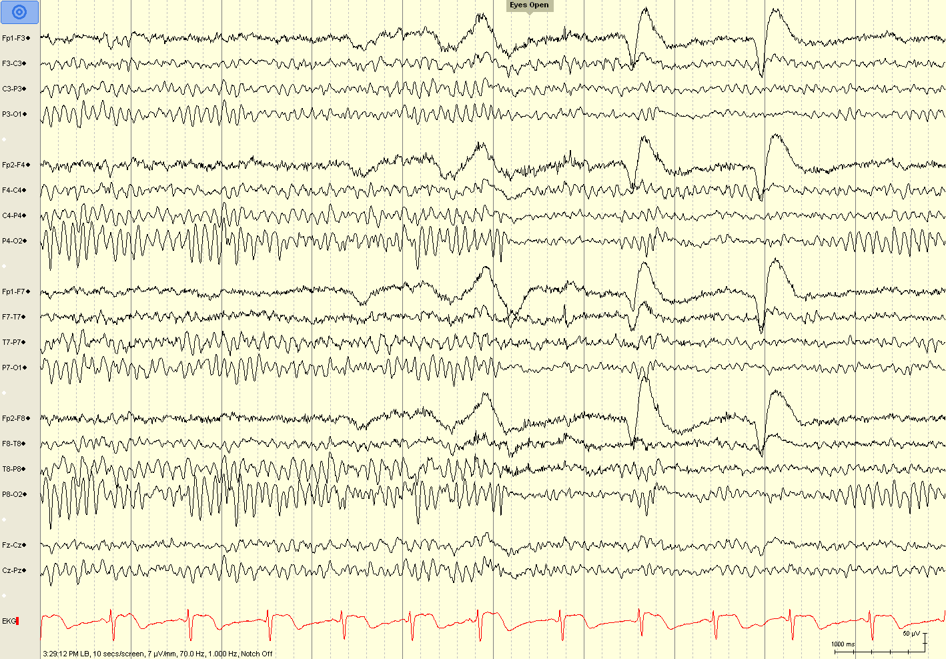

Slide 6
Posterior Dominant Rhythm
“the Alpha rhythm” (resting rhythm of occipital cortex)
Variants
  alpha squeak
  slow and fast variants
  paradoxical alpha – increases with alertness
Bancaud’s phenomenon (abnormal) – failure to attenuate with eye closure (ipsilateral pathway lesion)
Should be symmetric…?

Slide 7
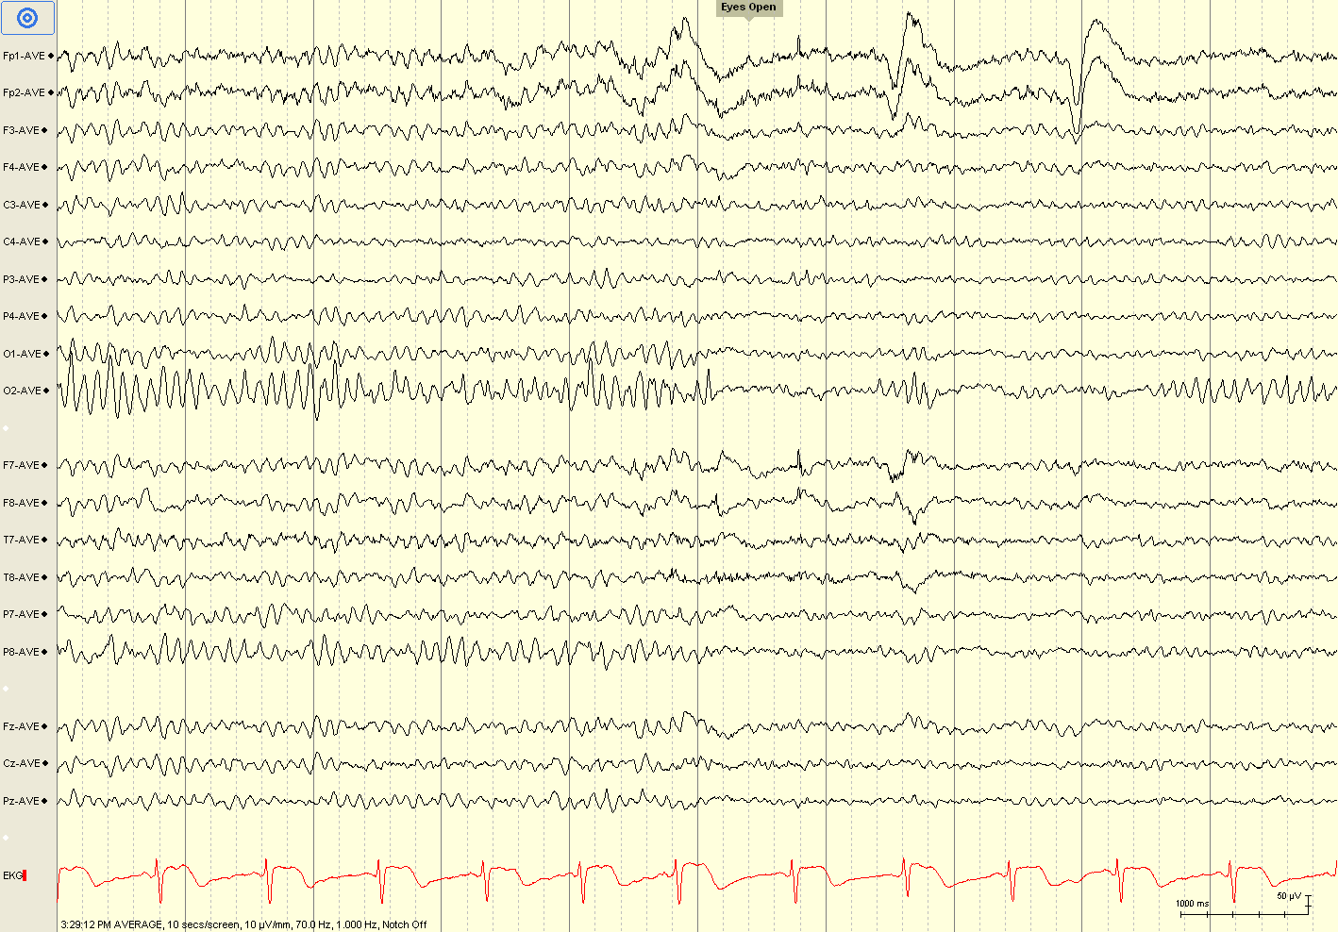
Notes:
Normal asymmetry

Slide 8
What is the allowable, normal asymmetry regarding the posterior dominant rhythm (alpha rhythm)?
Up to 35% higher amplitude on the right, and up to 35% higher amplitude on the left.
Up to 50% higher amplitude on the right, and up to 35% higher amplitude on the left.
Up to 35% higher amplitude on the right, and up to 50% higher amplitude on the left.
Up to 50% higher amplitude on the right, and up to 50% higher amplitude on the left.
Any asymmetry is considered abnormal
Notes:
B is the correct answer. Since the right side typically has a higher voltage than the left, a higher difference is allowable on the right. There are multiple theories as to why this phenomenon occurs; one suggests that skull is usually thicker on the left, another suggests that the left (typically dominant) hemisphere does not rest or idle and therefore is less synchronized.

Slide 9
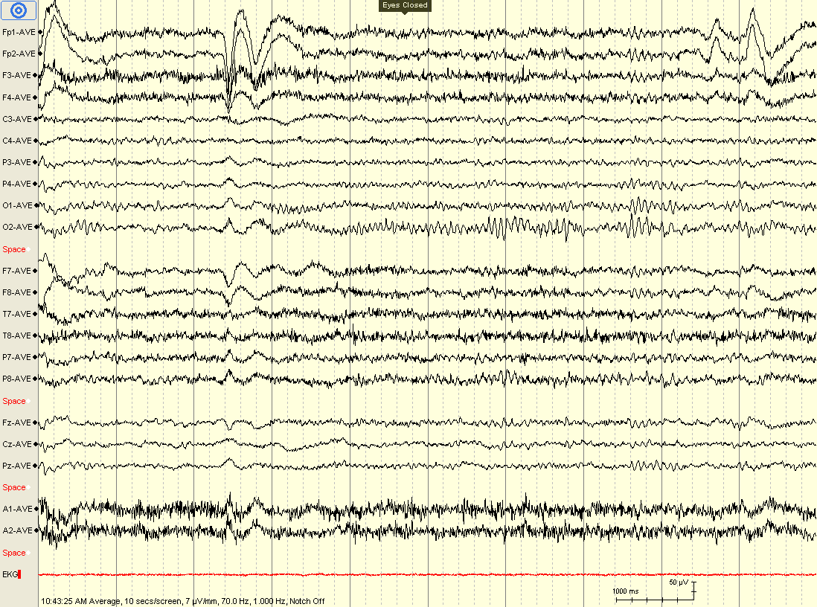
Alpha squeak pattern
Notes:
Alpha squeak

Slide 10
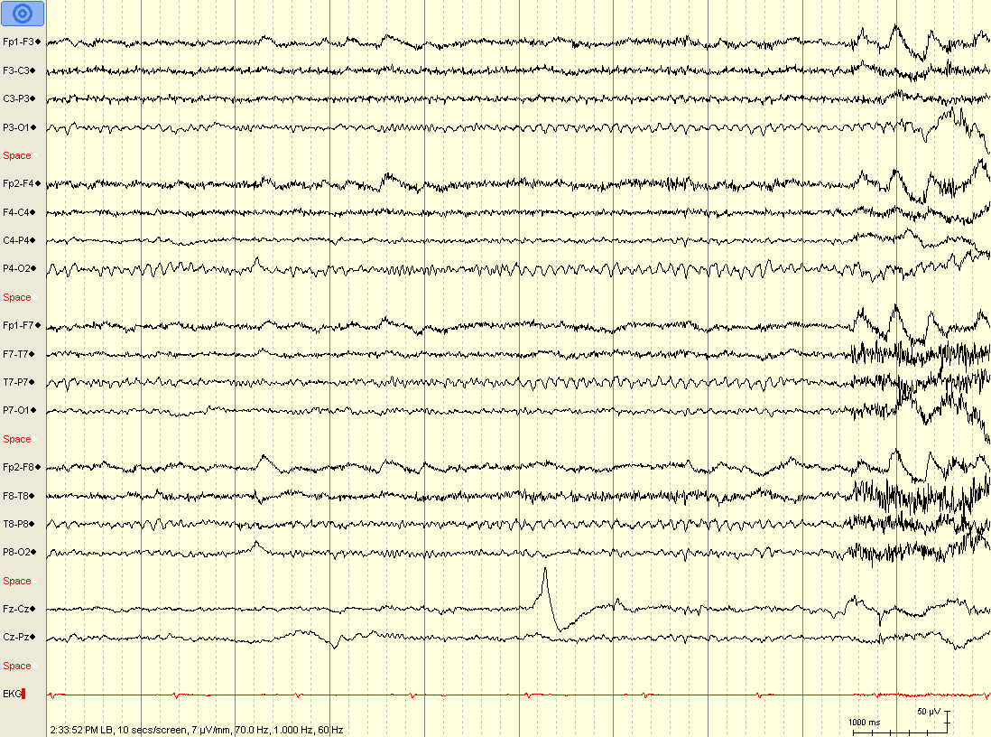
Fast alpha (PDR) variant
Notes:
Fast alpha variant

Slide 11
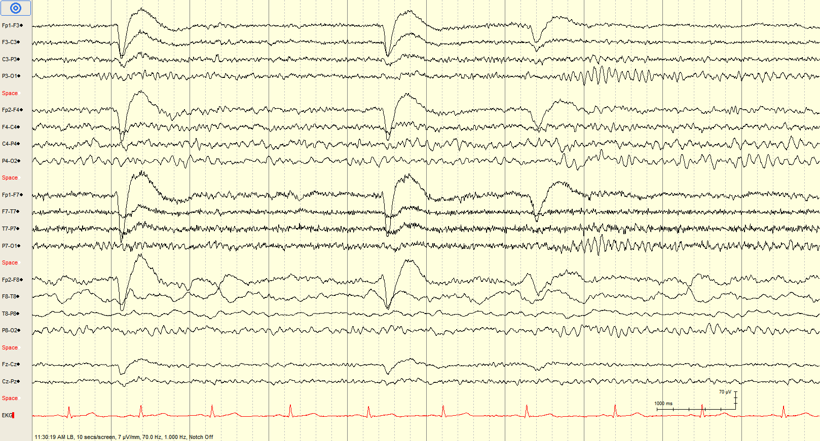
Bancaud phenomenon
(and right temporal-occipital slow activity)
Notes:
Bancaud’s phenomenon

Slide 12
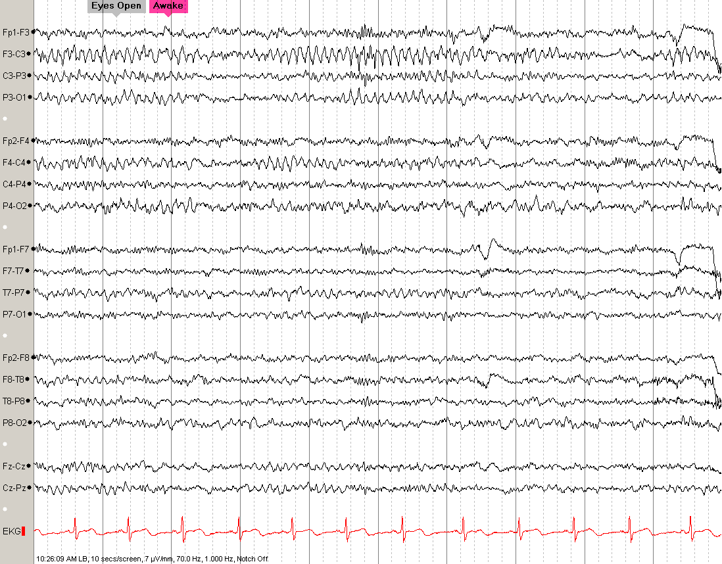

Slide 13
Mu rhythm
resting rhythm of central (premotor) cortex
  Alpha or theta (7-11 Hz) spiky rhythm
  Looks like the letter “µ”
Attenuates with contralateral limb movement (or even thinking about movement)
Often enhanced in presence of breach rhythm

Slide 14
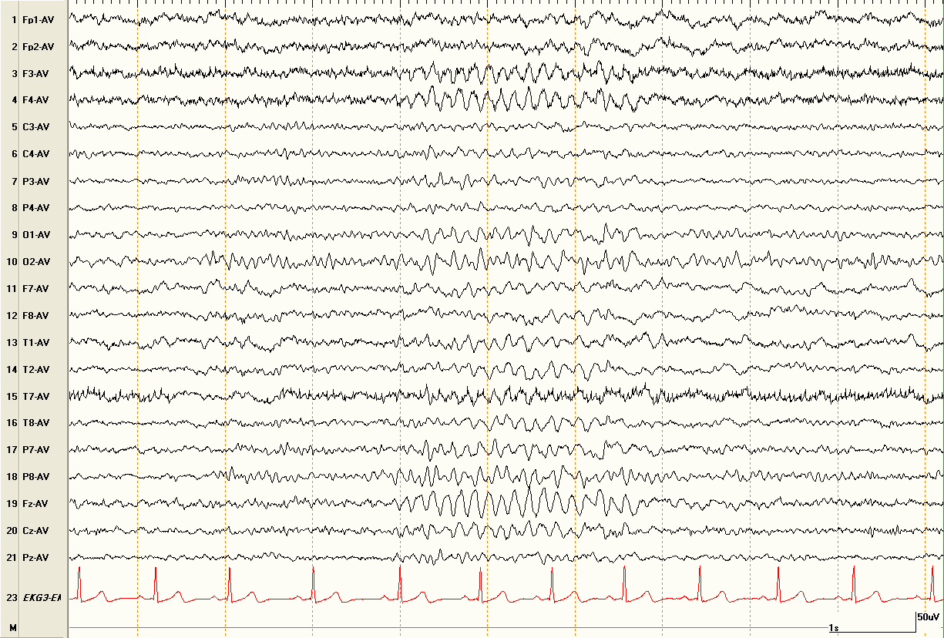

Slide 15
Midline theta
a.k.a. Ciganek rhythm
5-7 Hz sinusoidal activity maximal at Cz or Fz
may be spiky or arciform (mu-like)
Present in awake and drowsy states
Unrelated to eye opening, alerting, limb mvmt
May enhance with concentration (midline frontal theta)

Slide 16
Which of the following is NOT a characteristic of Stage N1 Sleep?
Slow lateral eye movements
Attenuation of posterior dominant rhythm
Emergence of sleep spindles
Emergence of vertex waves
Emergence of theta activity
Notes:
C is the correct answer. Sleep spindles emerge during stage N2. Stage N1 (a.k.a. drowsiness) is characterized by slow lateral eye movements, frontal beta activity, and theta activity. Vertex waves may be seen in both N1 and N2. In stage N1, the posterior dominant rhythm (alpha rhythm) will attenuate without eye opening, may slow by up to 1 Hz, and may become more anteriorly projected.

Slide 17
Drowsy EEG
Changes in PDR
  Attenuation without eye opening
  May slow by up to 1 Hz
  May become anteriorly projected
Slow lateral eye movements
Emergence of theta activity (often bursts)
Emergence of frontal beta activity

Slide 18
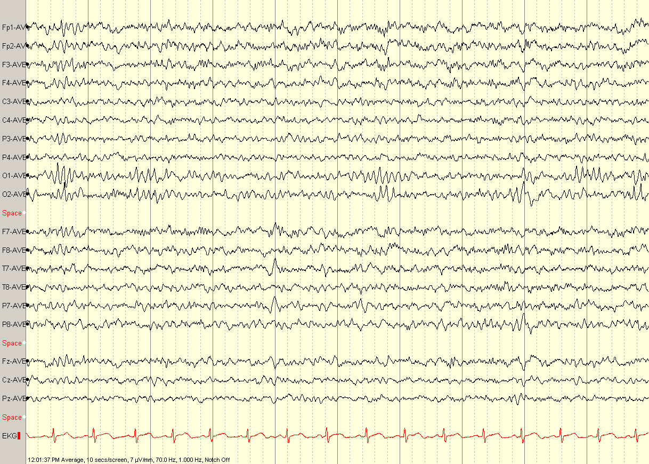
Notes:
PDR attenuation

Slide 19
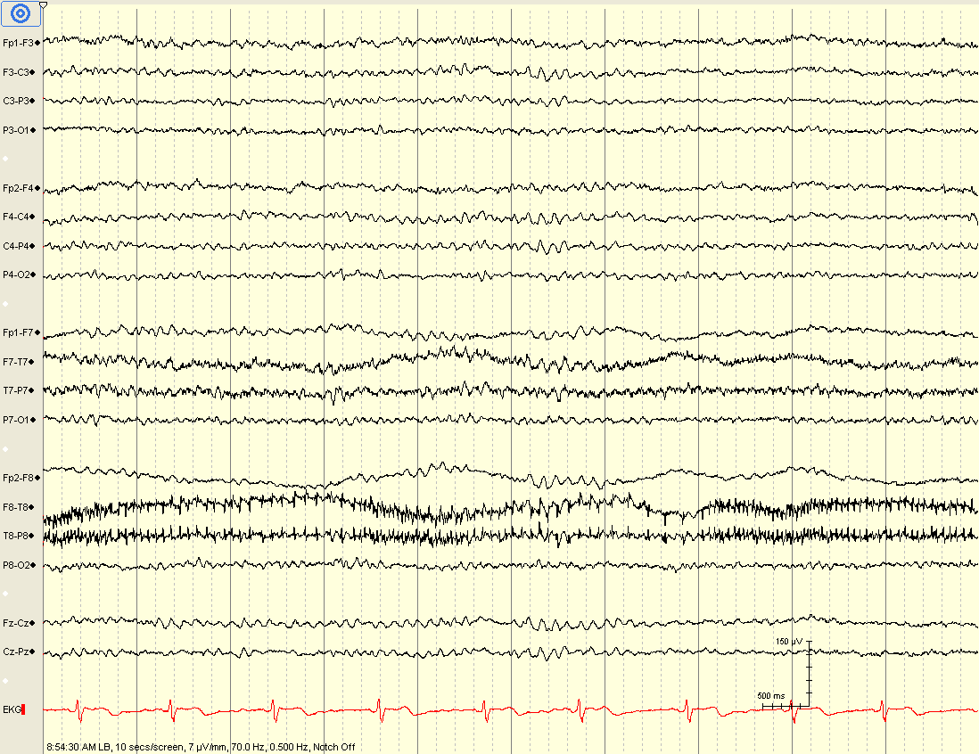
Notes:
19
SLEMs

Slide 20
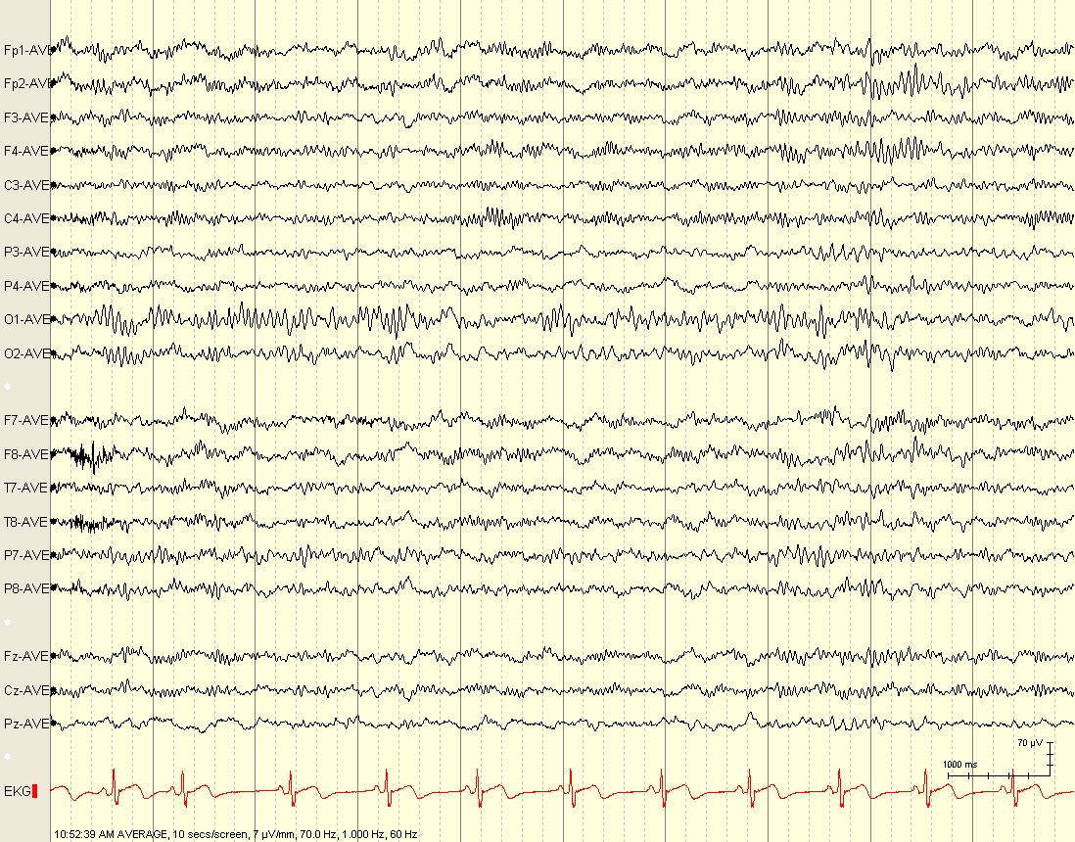
Notes:
Frontal beta activity

Slide 21
Frontal Beta Activity
*think benzodiazepines, barbiturates, and propofol
Resting rhythm of the frontal lobes
Best seen in drowsiness
Abnormal*
  Generalized
  High voltage (>30 µV)
  Persistent in sleep or awake states

Slide 22
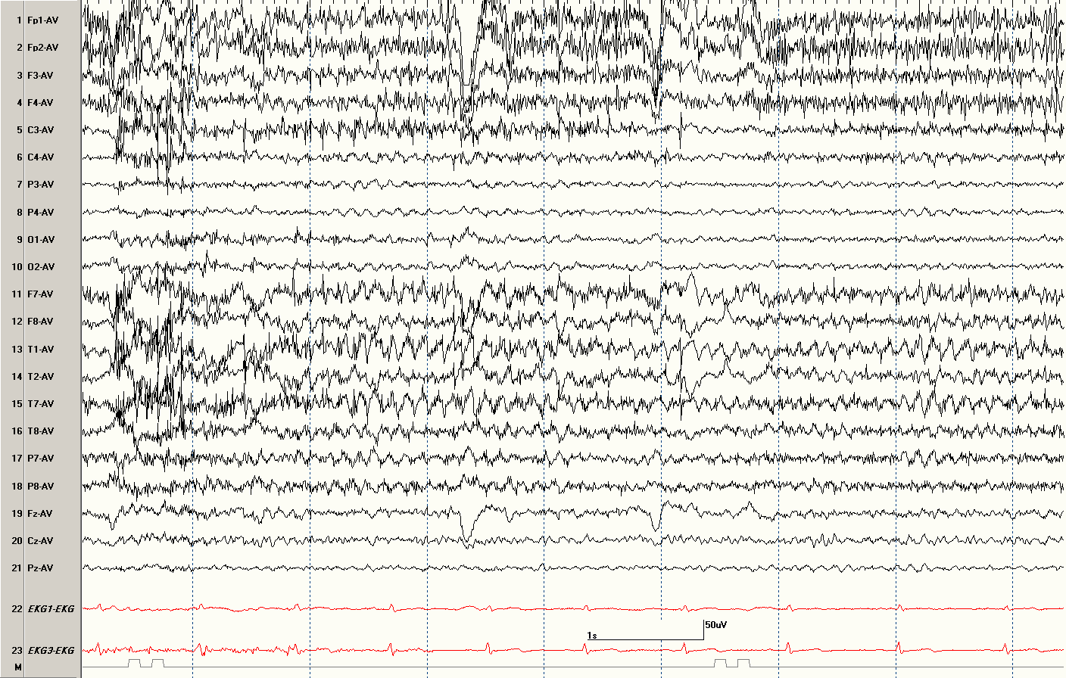

Slide 23
Third rhythm
Resting rhythm of temporal cortex
Alpha or theta (7-11 Hz) sinusoidal rhythm
May be asynchronous or unilateral
Can be seen in waking or drowsiness
If not seen, EEG may still be normal

Slide 24
Which of the following features is especially useful in differentiating normal / benign variants from true epileptiform discharges?
Benign variants attenuate during deeper sleep
Benign variants disrupt the background rhythms
Benign variants have associated slow activity
Benign variants are blunt (not sharp or spike)
Benign variants are low voltage
Notes:
A is the correct answer. Epileptiform discharges should enhance during deep sleep and should disrupt the background activity, often due to abnormal morphology, high voltage, and associated slow activity. Some benign variants are quite sharp or spiky looking, and therefore morphology or voltage alone are not necessarily reliable for differentiating from epileptiform discharges, though combing all of these features/criteria is quite useful for differentiating them.

Slide 25
Benign Variants
May be rhythmic or occur in isolation
May be high or low voltage (typically low)
May be quite “sharp” or “spiky”
Usually in drowsiness (not in deeper sleep)
Should not disrupt the background
  Have a “smooth” rhythm
  No associated slow / delta activity

Slide 26
Which of the following normal / benign variants occurs in waking (and not drowsiness)?
Wicket waves
14- and 6-Hz positive bursts
Small sharp spikes
Lambda waves
Psychomotor variant
Notes:
D is the correct answer. Lambda waves have positivity in the bilateral occipital regions and occurring during reading or scanning an image. Most of the remaining benign variants occur during drowsiness. Small sharp spikes (SSS) were also known as benign epileptiform transients of sleep (BETS), but the preferred term is benign sporadic sleep spikes (BSSS). Psychomotor variant is the very old term for rhythmic midtemporal theta of drowsiness (RMTD), but the preferred term is rhythmic temporal theta bursts of drowsiness (RTTBD).

Slide 27
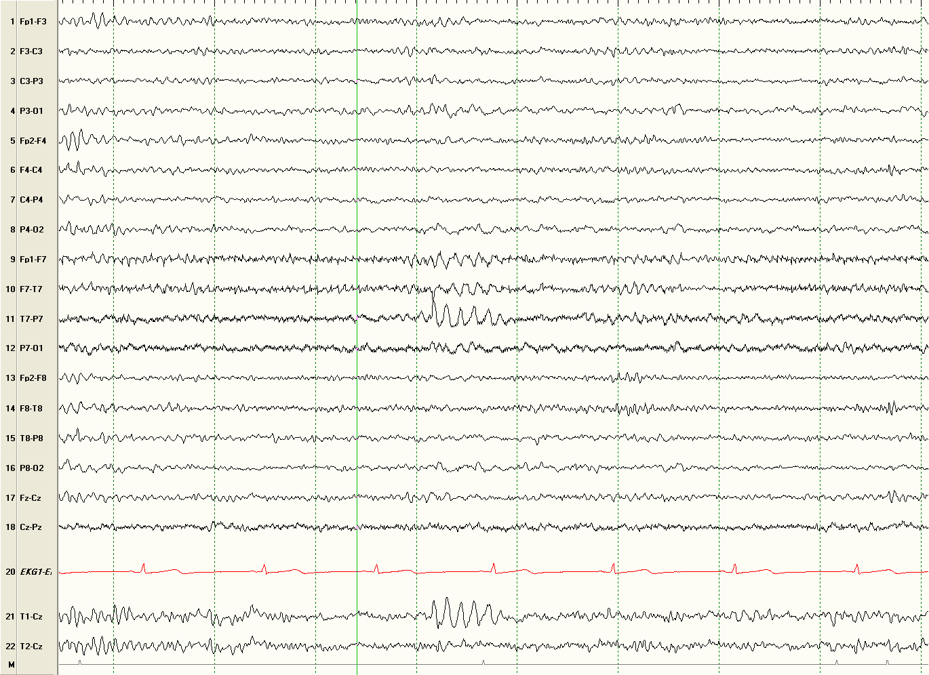

Slide 28
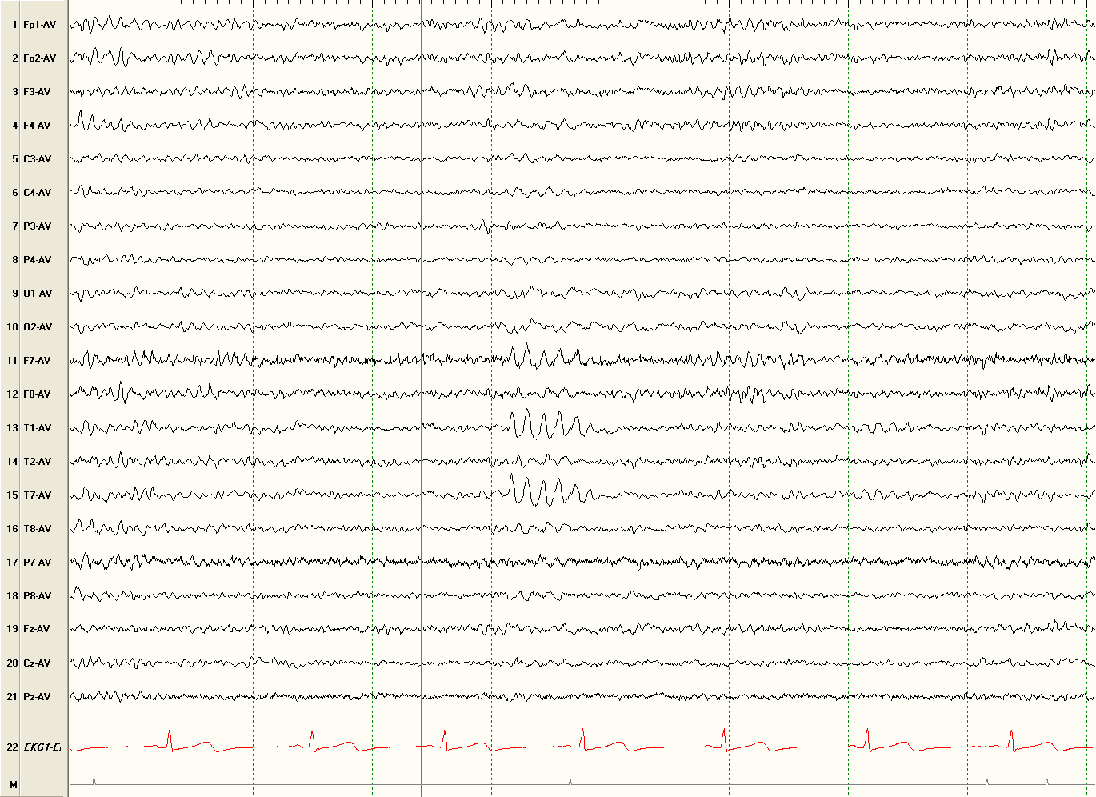

Slide 29
Wickets
Rhythmic bursts of monophasic 6-11 Hz activity
Seen bitemporally in drowsiness (not in deep sleep)
Typically occur in trains or runs
  don’t disrupt background
  tend to be “isosceles” (no aftergoing slow wave)
  when seen as single waves – may be overinterpreted
  surrounded by similar waves (may be lower amplitude)
On a spectrum with third rhythm
Notes:
Krauss paper may be a good reference

Slide 30
Wickets
One of the most commonly over-read benign variants
One study re-read EEGs of patients referred to an epilepsy center
  over 50% (25/46) had wicket rhythms misinterpreted as epileptiform
  these 25 patients had nonepileptic clinical episodes
Wicket rhythms tend to be more LEFT sided (“classic” teaching is incorrect)
Krauss GL, et al. "Clinical and EEG features of patients with EEG wicket rhythms misdiagnosed with epilepsy." Neurology 64.11 (2005): 1879-1883.
Azzam RH, Arain AM, and Azar NJ. "Revisiting the Laterality of Wicket Spikes With Continuous EEG." Journal of Clinical Neurophysiology 32.2 (2015): e8-e11.
Vallabhaneni M, et al. "A case–control study of wicket spikes using video-EEG monitoring." Seizure 22.1 (2013): 14-19.

Slide 31
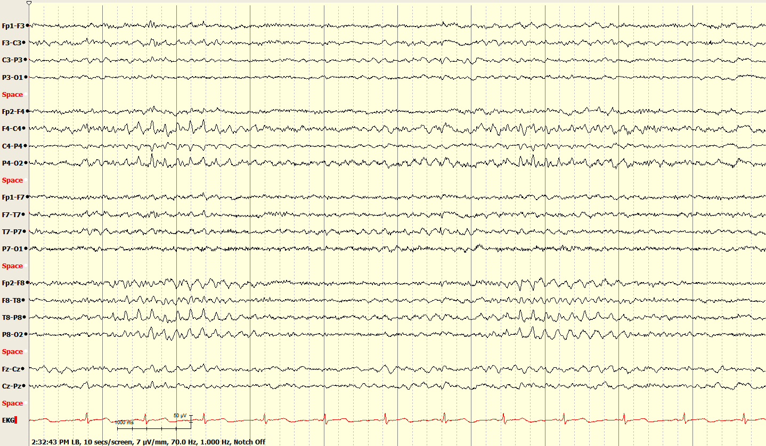

Slide 32
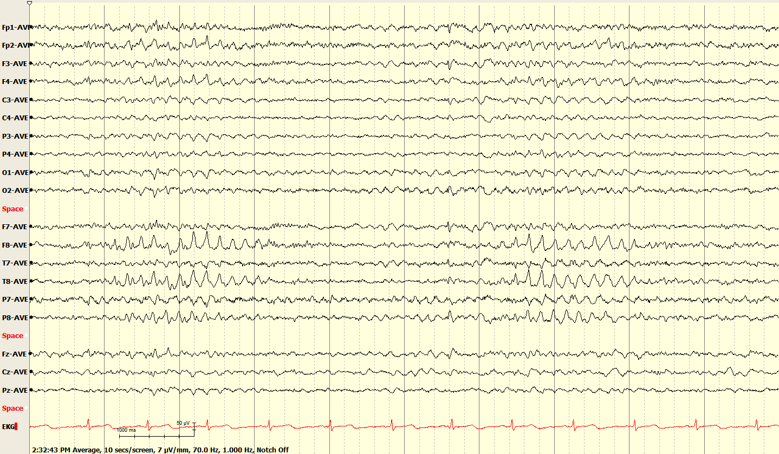

Slide 33
Rhythmic Temporal Theta Bursts of Drowsiness (RTTBD)
Rhythmic Midtemporal Theta of Drowsiness (RMTD)
Psychomotor variant
Bursts of rhythmic, notched 5-7 Hz activity
Bi-synchronous or bilateral independent in the midtemporal regions
Seen in drowsiness (disappear in deeper sleep)

Slide 34
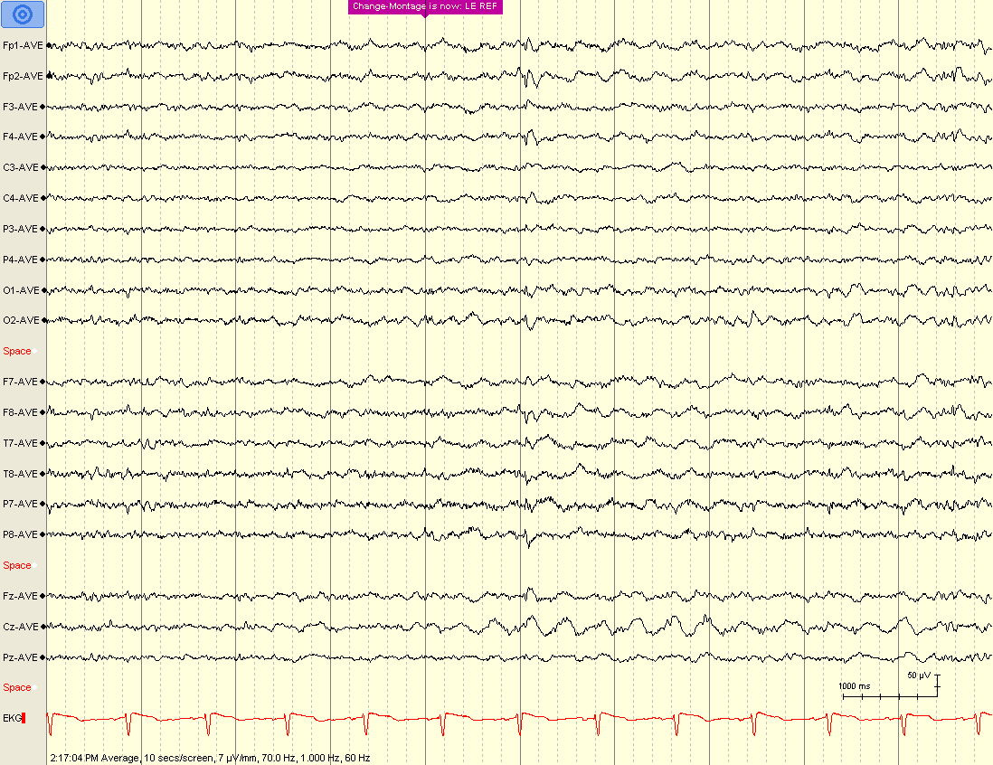

Slide 35
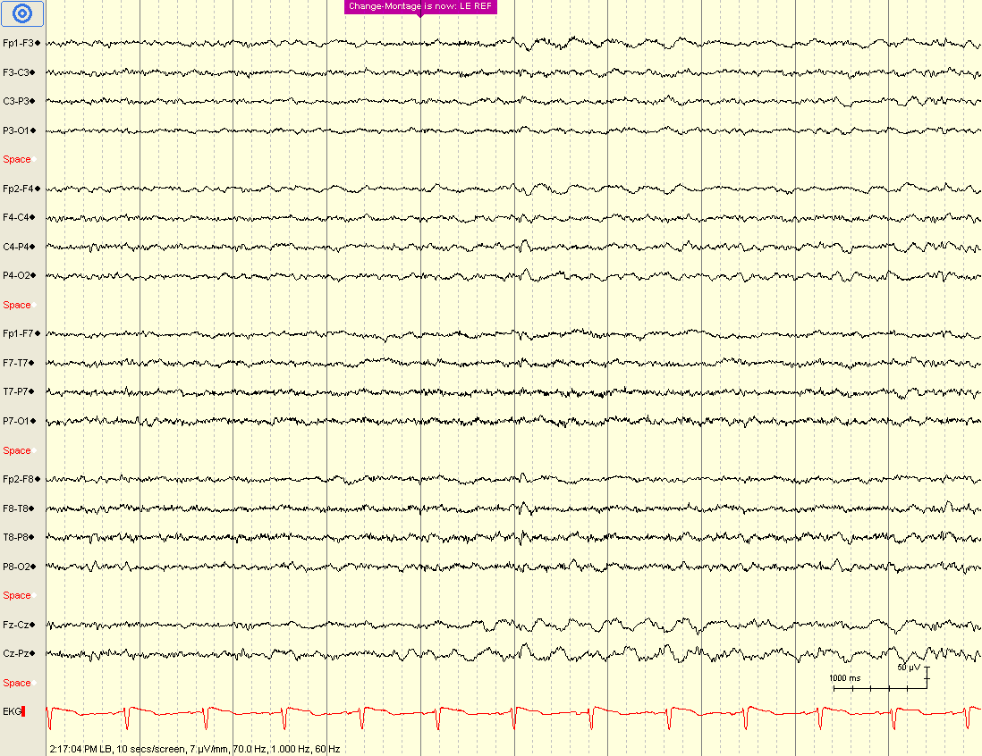

Slide 36
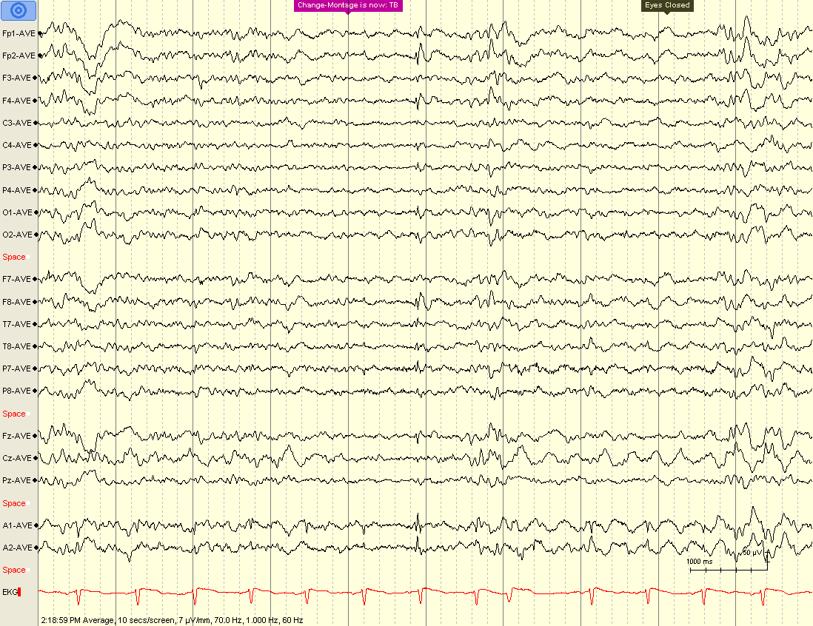

Slide 37
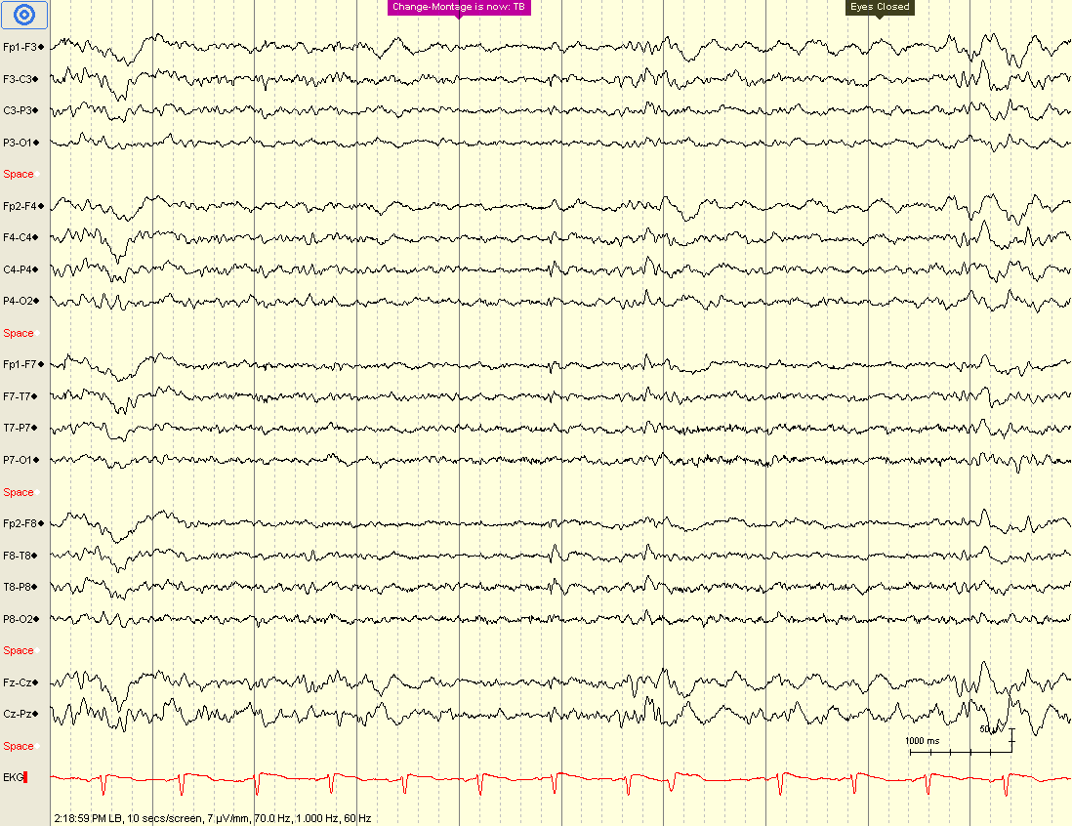

Slide 38
Benign Sporadic Sleep Spikes (BSSS)
Benign Epileptiform Transients of Sleep (BETS)
Small Sharp Spikes (SSS)
Typically < 50 ms and < 50μV
May be diphasic (morphology varies)
May have a transverse dipole
Usually seen bilaterally independently
Appear in drowsiness (disappear in deeper sleep)
Do not distort background; no associated slow activity

Slide 39
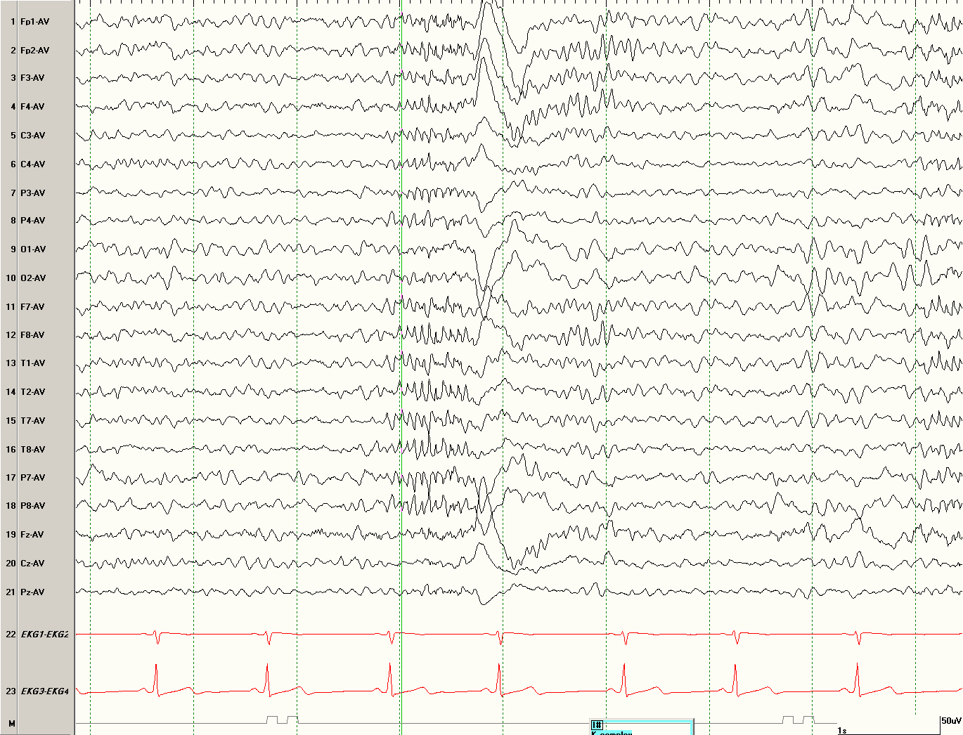

Slide 40
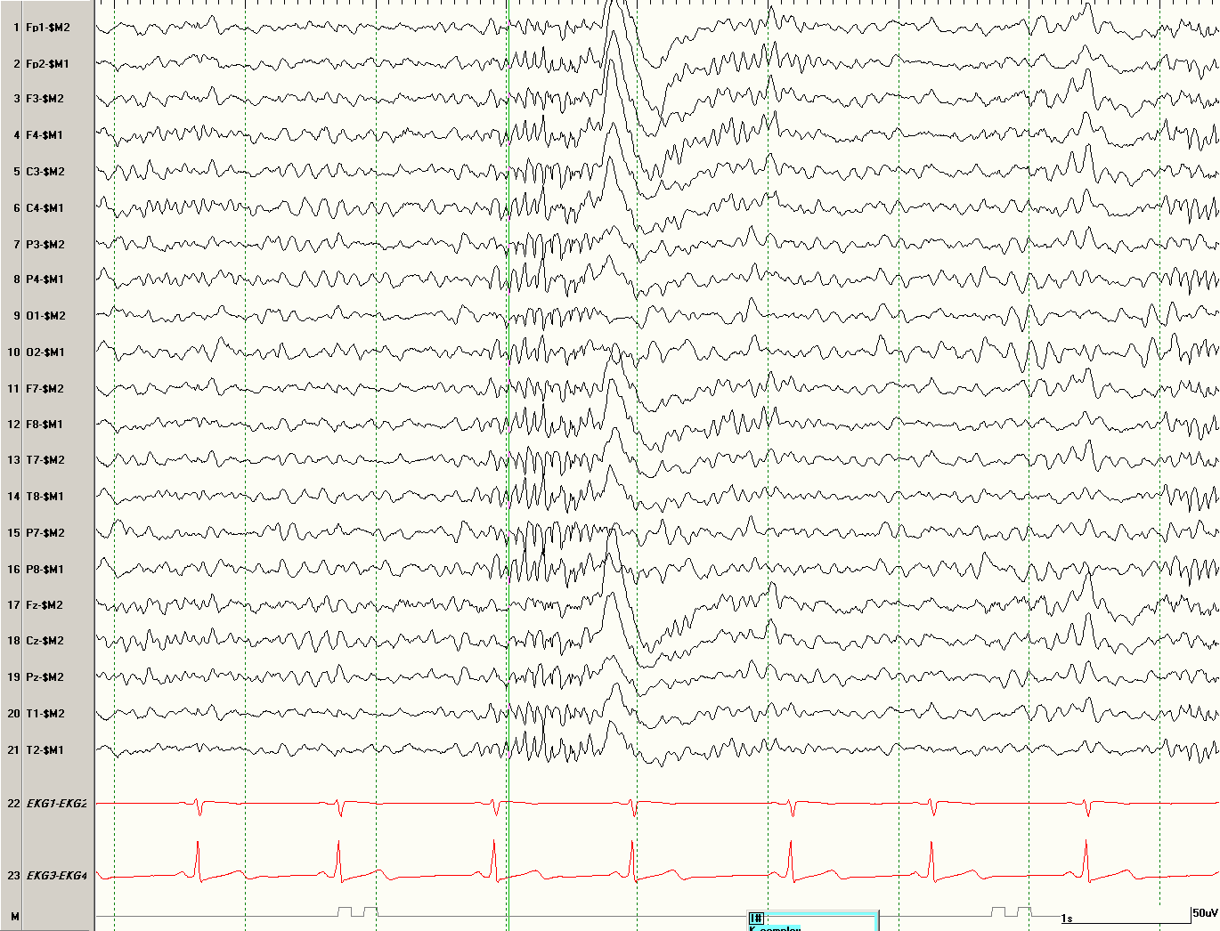

Slide 41
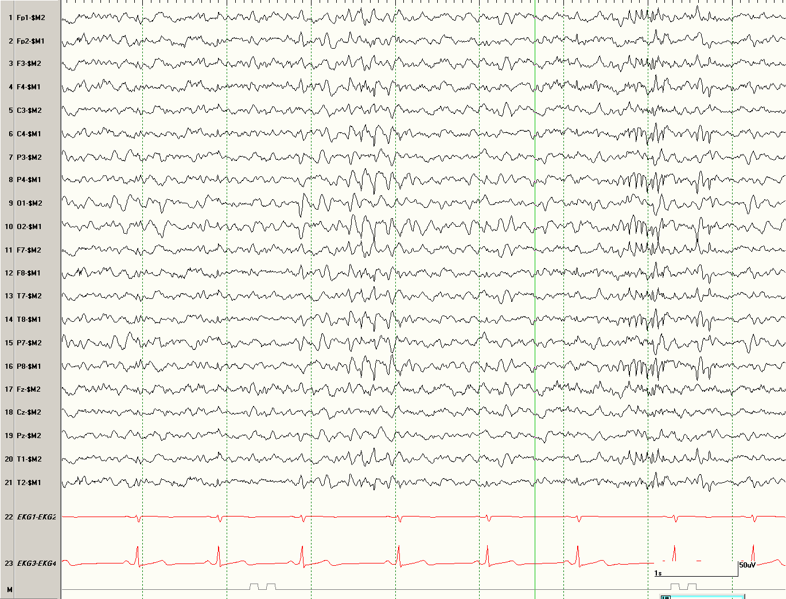

Slide 42
14- and 6-Hz positive bursts (ctenoids)
Intermixed 14 Hz and 6-7 Hz activity
Wide field positive polarity (posterior temporal predominance)
Best confirmed on contralateral ear montage (long distance referential)
Occur in N1 or N2 sleep
Seen in normal adolescents but also in hepatic disease (Reye syndrome, hepatic encephalopathy)

Slide 43
6-Hz Phantom Spike-and-Wave
Spike is often very low voltage (“phantom”)
Occur in two forms:
WHAMs have an association with epilepsy (may actually represent true epileptiform frontally predominant generalized spike-and-wave)
WHAM | FOLD
Waking | Female
High Amplitude | Occipital
Anterior | Low Amplitude
Male | Drowsiness

Slide 44
Which of the following features is necessary to diagnosis SREDA (subclinical rhythmic electrographic discharges of adults)?
Age > 65 years
Lack of clinical signs during discharge
Normal EEG outside of SREDA
Occurs during N2 sleep
Occurs during N3 sleep
Notes:
B is the correct answer. Although SREDA is typically seen in older adults (> 50 years), there is no specific age requirement. The presence or absence of abnormalities during parts of the study outside of SREDA is irrelevant and independent of this finding. SREDA typically occurs during the awake or drowsy state. It may have a prolonged duration and has been called “a seizure in reverse”; meaning it may start with posteriorly predominant delta activity that evolves to theta and at times to faster frequencies. The major clue to identifying this benign variant is the lack of clinical features; patient testing during the discharge is critical.

Slide 45
Subclinical Rhythmic Electrographic Discharges in Adults (SREDA)
Mainly seen in older adults in waking or drowsiness (often during HV)
Wide field (parietal or posterior temporal predominance)
Mixed delta-theta rhythmic activity that evolves to faster frequencies over 20-80 seconds
Has been described as ‘seizure’ in reverse
Must be without clinical signs

Slide 46
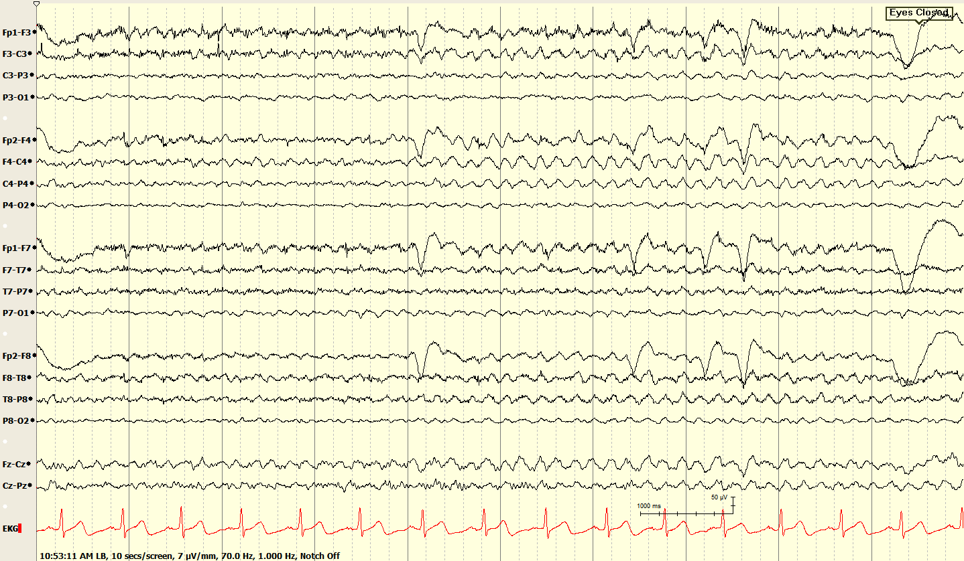

Slide 47
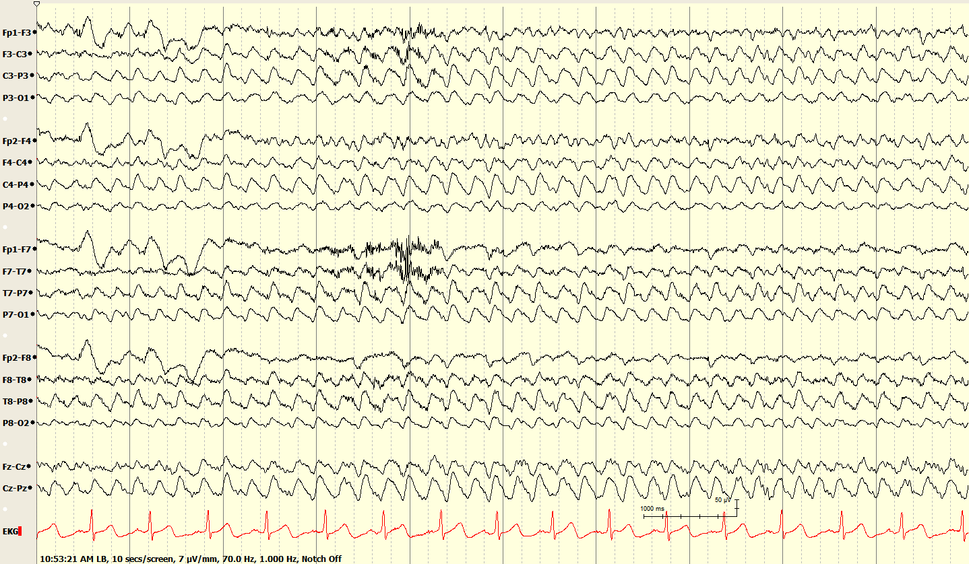

Slide 48
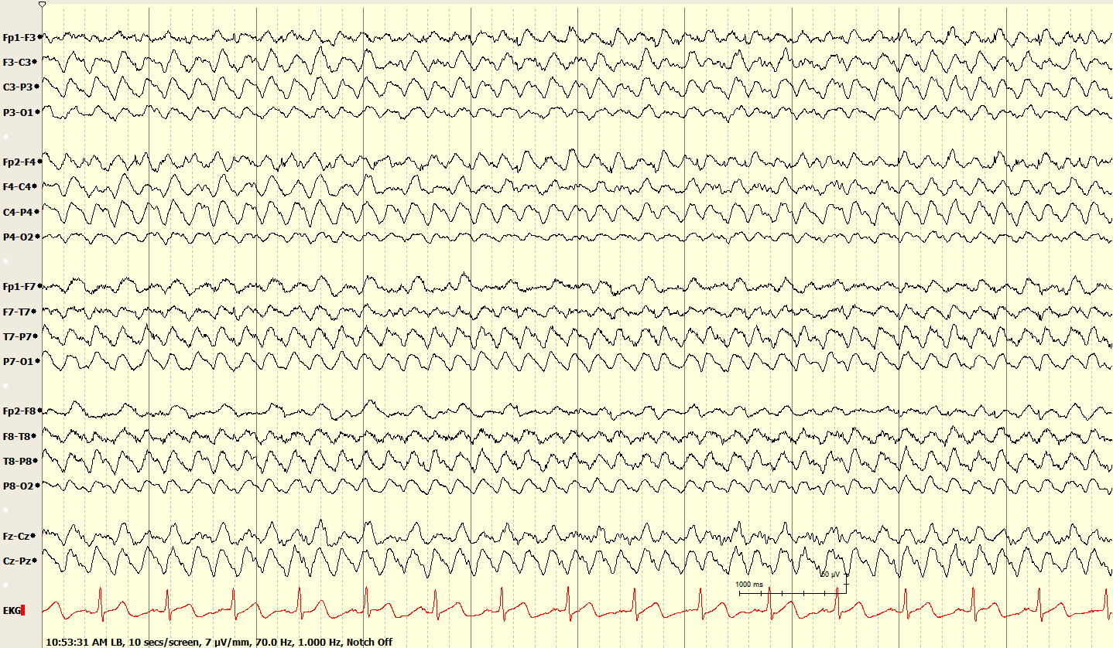

Slide 49
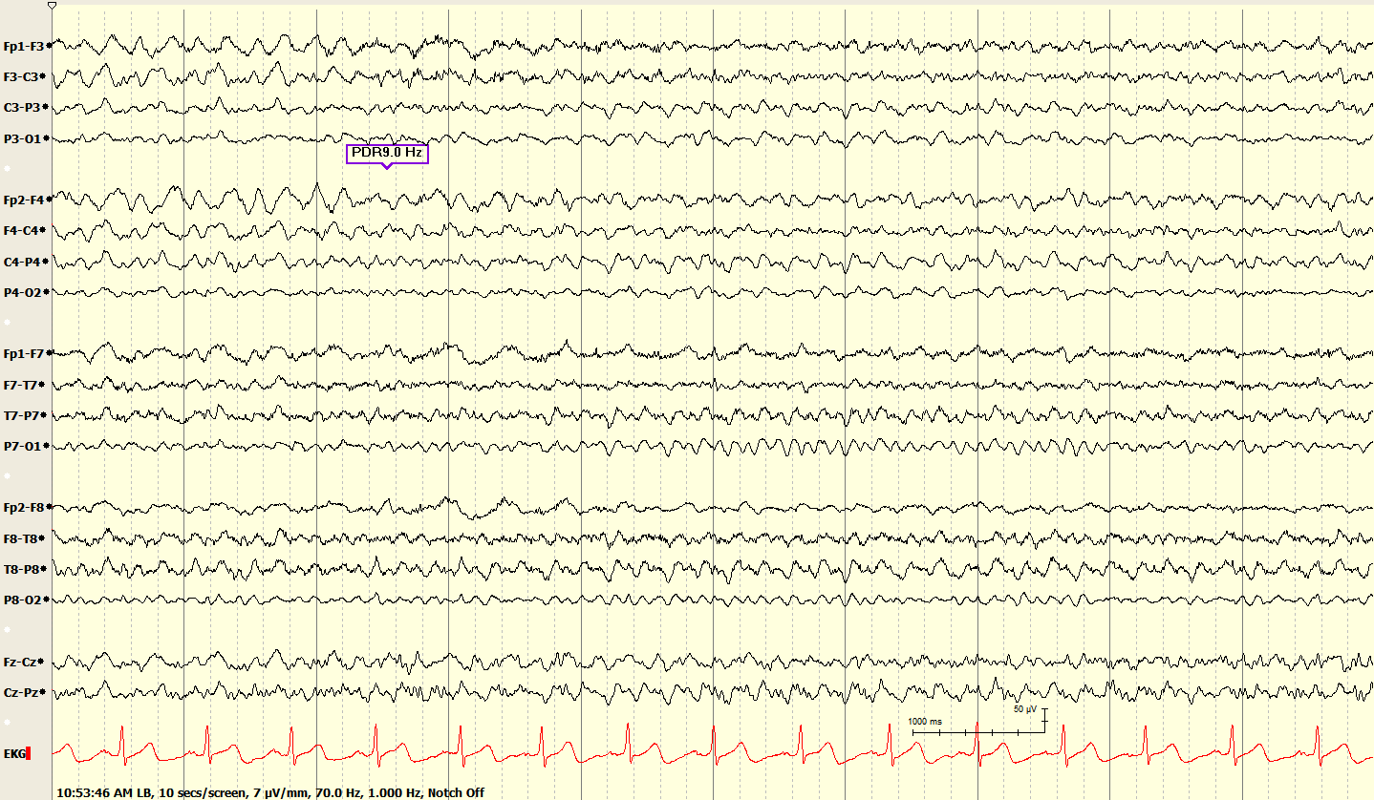

Slide 50
Sleep EEG
Stage N1 - drowsiness
Stage N2 - specific architecture
Stage N3 - slow wave sleep
REM - rapid eye movement

Slide 51
Patterns in Stage N2 Sleep*
Sleep spindles
K complexes
Vertex waves (can also be in stage 1)
POSTS
* all are normal, though some appear “sharp”

Slide 52
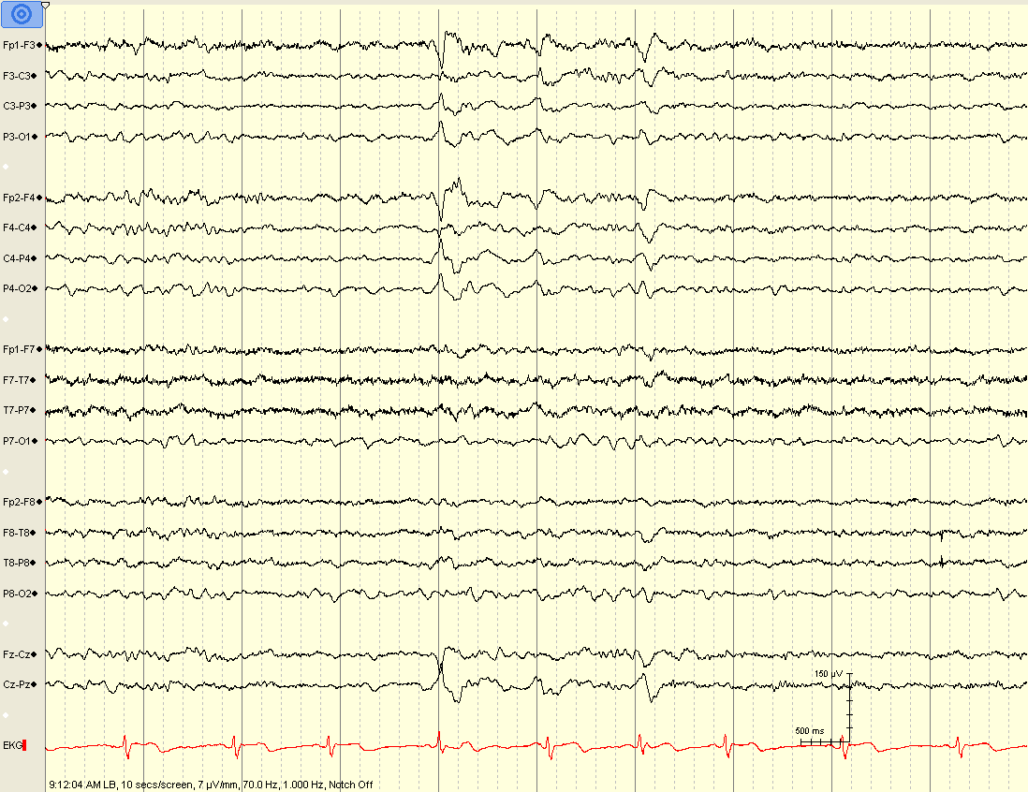
Notes:
52

Slide 53
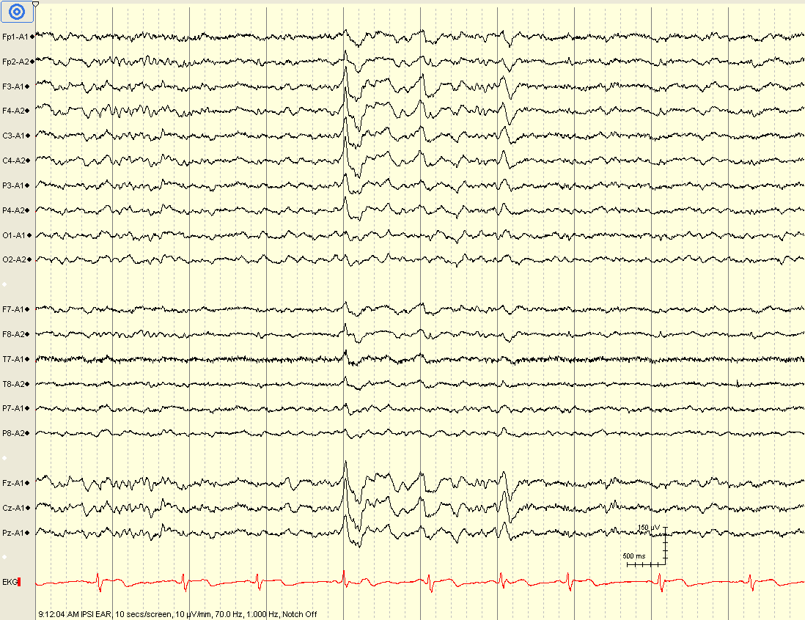
Notes:
53

Slide 54
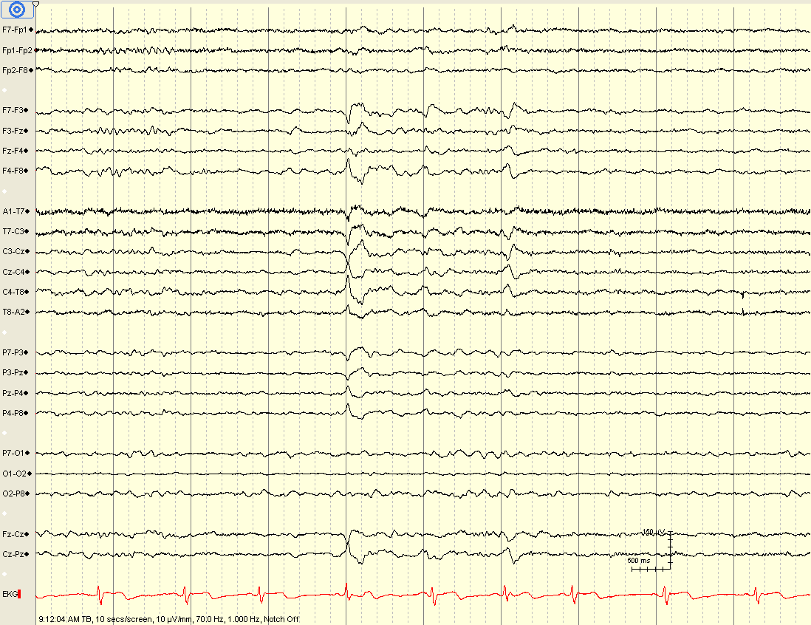
Notes:
54

Slide 55
Vertex Waves
High voltage, sharp looking, surface negative waves
Originate at Cz (the vertex)
Thought to be generated by the thalamus
Notes:
55

Slide 56
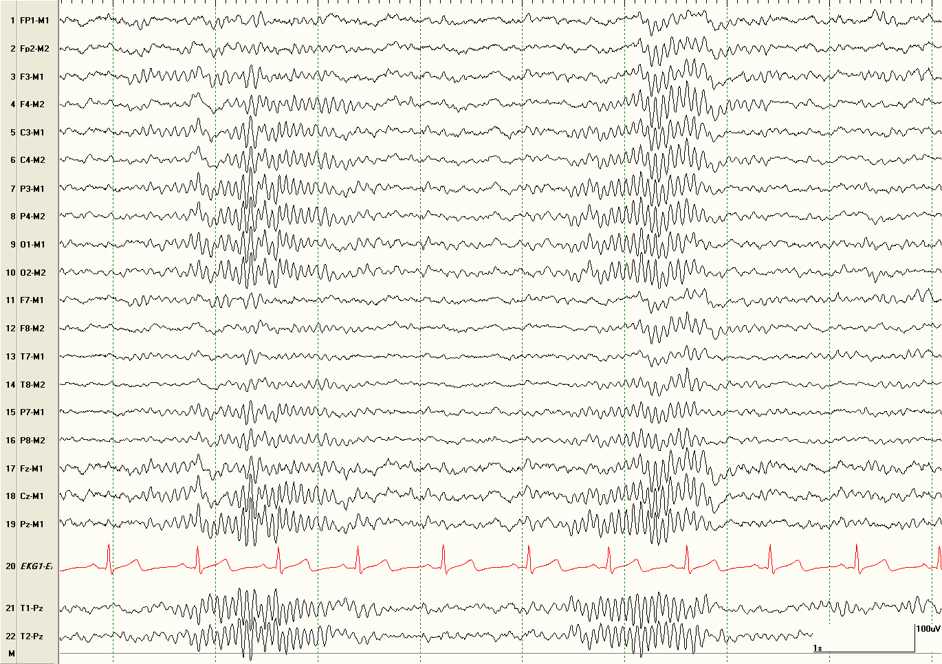
Notes:
56

Slide 57
Sleep spindles
Bursts of beta activity (12-16 Hz)
  symmetric and synchronous (age > 2 yrs)
  fronto-central head region
  last 1-1.5 seconds
Thought to be generated by the thalamus
Notes:
57

Slide 58
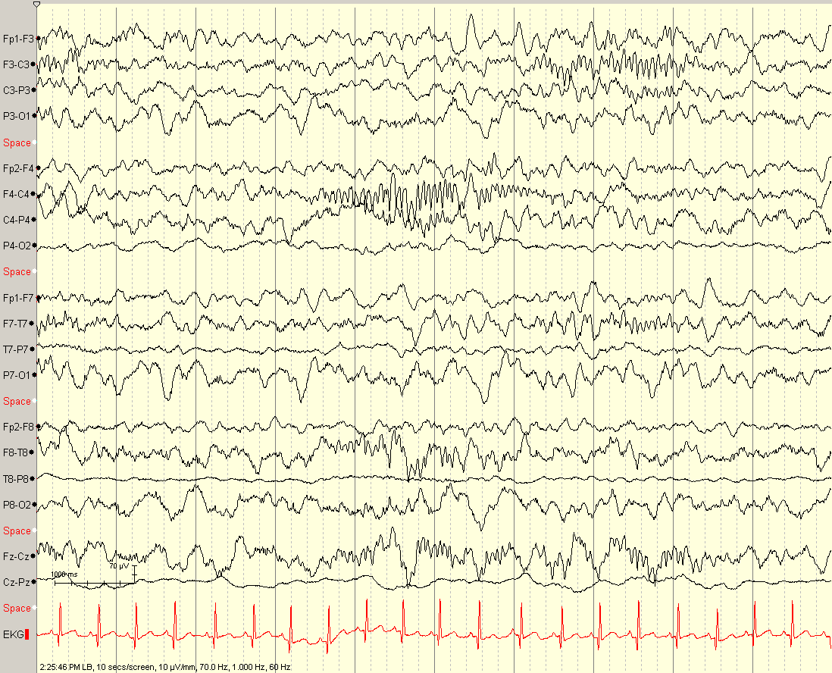
Notes:
Nascent, primitive spindles

Slide 59
By what age should sleep spindles become synchronous?
2 months
6 months
12 months
2 years
6 years
Notes:
D is the correct answer. Sleep spindles first appear around age 2 months. They tend to be longer duration and higher frequency at this immature stage. By 2 years of age, they should become synchronous (after that age, asynchrony would be considered abnormal).

Slide 60
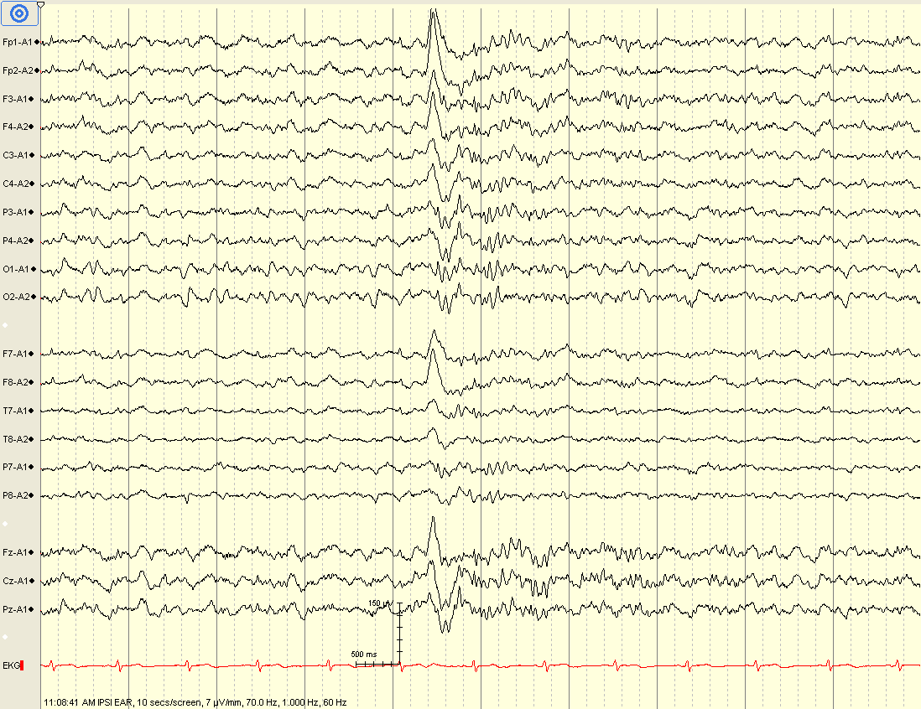

Slide 61
K complexes
Broad 0.5-2 second long wave
Fronto-central predominance
Might be followed by a sleep spindle
related to arousal (noise, clapping, knock)

Slide 62
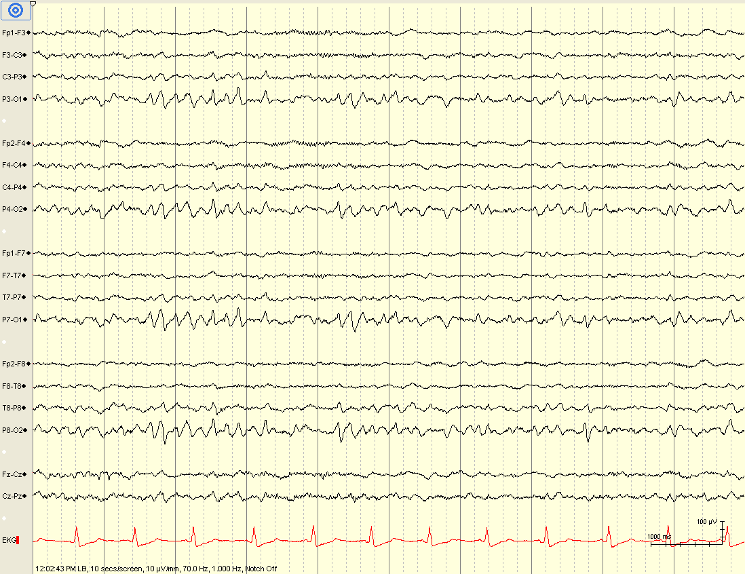
Notes:
62

Slide 63
POSTS
Positive Occipital Sharp Transients of Sleep
That’s exactly what they are.
Should be symmetric and synchronous.
Notes:
63

Slide 64
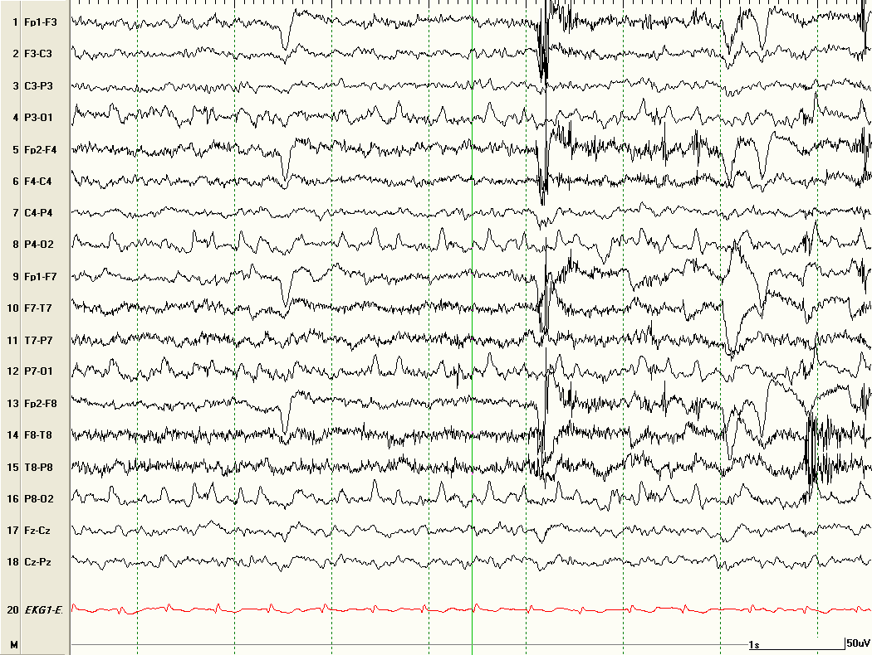
Are these POSTS?

Slide 65
Lambda Waves
A sharp looking wave that has a positive polarity in the occipital regions
looks like the letter “λ”
synchronous and symmetric
Occurs when scanning lines or looking at an picture (visual activity)

Slide 66
Summary
Awake EEG includes PDR, Mu, and third rhythm
Benign variants do not disrupt the background, do not persist into deep sleep, and must not be over-interpreted
Normal N2 sleep structures include K complexes, vertex waves, sleep spindles, and POSTS

